Slide 2
far above all rule and authority and power and dominion, and every name that is named, not only in this age but also in the one to come. And He put all things in subjection under His feet, and gave Him as head over all things to the church, which is His body, the fullness of Him who fills all in all. (Ephesians 1:21-23)

Slide 3
For you are all sons of God through faith in Christ Jesus. For all of you who were baptized into Christ have clothed yourselves with Christ. There is neither Jew nor Greek, there is neither slave nor free man, there is neither male nor female; for you are all one in Christ Jesus. And if you belong to Christ, then you are Abraham’s descendants, heirs according to promise.
(Galatians 3:26-29)

Slide 4
1. The FOUNDATION Is Right

Slide 5
Now when Jesus came into the district of Caesarea Philippi, He was asking His disciples, “Who do people say that the Son of Man is?” And they said, “Some say John the Baptist; and others, Elijah; but still others, Jeremiah, or one of the prophets.” He *said to them, “But who do you say that I am?”

Slide 6
Simon Peter answered, “You are the Christ, the Son of the living God.” And Jesus said to him, “Blessed are you, Simon Barjona, because flesh and blood did not reveal this to you, but My Father who is in heaven. “I also say to you that you are Peter, and upon this rock I will build My church; and the gates of Hades will not overpower it.

Slide 7
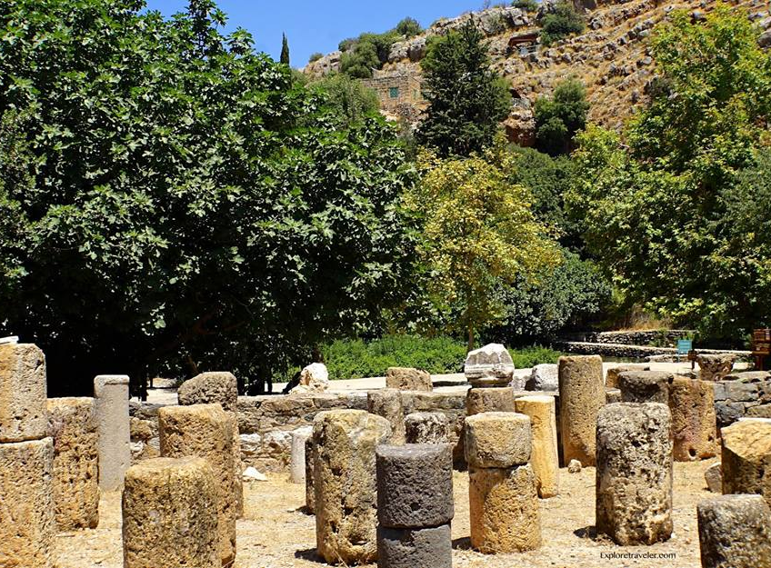

Slide 8
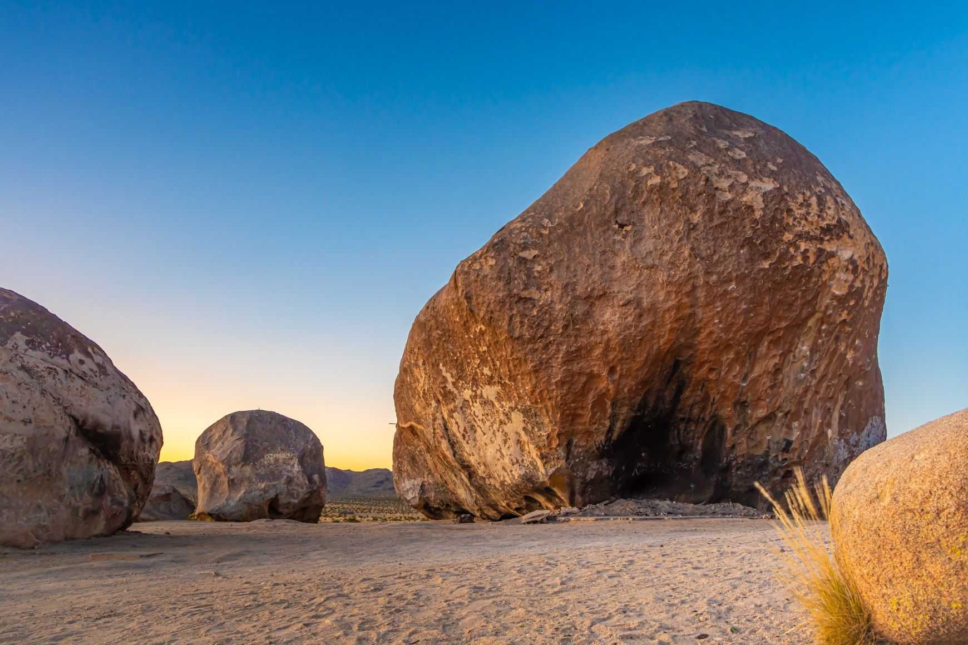

Slide 9
you also, as living stones, are being built up as a spiritual house for a holy priesthood, to offer up spiritual sacrifices acceptable to God through Jesus Christ. (1 Peter 2:5)

Slide 10
Therefore thus says the Lord GOD, “Behold, I am laying in Zion a stone, a tested stone, A costly cornerstone for the foundation, firmly placed. He who believes in it will not be disturbed. (Isaiah 28:16)

Slide 11
let it be known to all of you and to all the people of Israel, that by the name of Jesus Christ the Nazarene, whom you crucified, whom God raised from the dead—by this name this man stands here before you in good health. “He is the STONE WHICH WAS REJECTED by you, THE BUILDERS, but WHICH BECAME THE CHIEF CORNER stone. “And there is salvation in no one else; for there is no other name under heaven that has been given among men by which we must be saved.” (Acts 4:10-12)

Slide 12
He is also head of the body, the church; and He is the beginning, the firstborn from the dead, so that He Himself will come to have first place in everything. (Colossians 1:18)

Slide 13
2. The FAITH Is Right

Slide 14
Beloved, while I was making every effort to write you about our common salvation, I felt the necessity to write to you appealing that you contend earnestly for the faith which was once for all handed down to the saints. (Jude 3)

Slide 15
“As Moses lifted up the serpent in the wilderness, even so must the Son of Man be lifted up; so that whoever believes will in Him have eternal life. “For God so loved the world, that He gave His only begotten Son, that whoever believes in Him shall not perish, but have eternal life. “For God did not send the Son into the world to judge the world, but that the world might be saved through Him. (John 3:14-17)

Slide 17
So they went on their way from the presence of the Council, rejoicing that they had been considered worthy to suffer shame for His name. And every day, in the temple and from house to house, they kept right on teaching and preaching Jesus as the Christ. (Acts 5:41-42)

Slide 18
And when I came to you, brethren, I did not come with superiority of speech or of wisdom, proclaiming to you the testimony of God. For I determined to know nothing among you except Jesus Christ, and Him crucified. I was with you in weakness and in fear and in much trembling, and my message and my preaching were not in persuasive words of wisdom, but in demonstration of the Spirit and of power, so that your faith would not rest on the wisdom of men, but on the power of God. (1 Corinthians 2:1-5)

Slide 19
3. The FELLOWSHIP Is Right

Slide 20
So then, those who had received his word were baptized; and that day there were added about three thousand souls. They were continually devoting themselves to the apostles’ teaching and to fellowship, to the breaking of bread and to prayer. (Acts 2:41-42)

Slide 22
Suffer Together (1 Corinthians 12:26)
Rejoice Together (Romans 12:15)
Carry Each Other’s Burdens (Galatians 6:2)
Restore Each Other (6:1)
Pray For Each Other (Romans 15:30)
Encourage Each Other (1:12)
Forgive Each Other (Ephesians 4:32)
Confess To One Another (James 5:16)
Be Truthful To Each Other (Ephesians 4:25)
Spur Each Other To Good Deeds (Hebrews 10:24)
And Give To Each Other (Philippians 4:14-15)

Slide 23
4. The FOCUS Is Right

Slide 25
5. The FUTURE Is Right

Slide 26
For as in Adam all die, so also in Christ all will be made alive. But each in his own order: Christ the first fruits, after that those who are Christ’s at His coming, then comes the end, when He hands over the kingdom to the God and Father, when He has abolished all rule and all authority and power. ( 1 Corinthians 15:22-24)

Slide 27
For the Lord Himself will descend from heaven with a shout, with the voice of the archangel and with the trumpet of God, and the dead in Christ will rise first. Then we who are alive and remain will be caught up together with them in the clouds to meet the Lord in the air, and so we shall always be with the Lord. Therefore comfort one another with these words. (1 Thessalonians 4:16-18)

Slide 28
For the love of Christ controls us, having concluded this, that one died for all, therefore all died; and He died for all, so that they who live might no longer live for themselves, but for Him who died and rose again on their behalf. 2 Corinthians 5:14-15)

Slide 29
Now, little children, abide in Him, so that when He appears, we may have confidence and not shrink away from Him in shame at His coming. If you know that He is righteous, you know that everyone also who practices righteousness is born of Him. (1 John 2:28-29)

Slide 30
