Slide 3
To Follow Christ To Think As He Thought To Obey As Christ Obeyed To Grow As Christ Grew To Love As Christ Loved To Give As Christ Gave To Forgive As Christ Forgave

Slide 4
But God demonstrates His own love toward us, in that while we were yet sinners, Christ died for us. Much more then, having now been justified aby His blood, we shall be saved from the wrath of God through Him. (Romans 5:8-9)

Slide 5
Let all bitterness and wrath and anger and clamor and slander be put away from you, along with all malice. Be kind to one another, tender-hearted, forgiving each other, just as God in Christ also has forgiven you. Therefore be imitators of God, as beloved children; and walk in love, just as Christ also loved you and gave Himself up for us, an offering and a sacrifice to God as a fragrant aroma. (Ephesians 4:31-5:2)

Slide 7
Let all bitterness and wrath and anger and clamor and slander be put away from you, along with all malice. Be kind to one another, tender-hearted, forgiving each other, just as God in Christ also has forgiven you. Therefore be imitators of God, as beloved children; and walk in love, just as Christ also loved you and gave Himself up for us, an offering and a sacrifice to God as a fragrant aroma. (Ephesians 4:31-5:2)

Slide 8
So, as those who have been chosen of God, holy and beloved, put on a heart of compassion, kindness, humility, gentleness and patience; bearing with one another, and forgiving each other, whoever has a complaint against anyone; just as the Lord forgave you, so also should you. Beyond all these things put on love, which is the perfect bond of unity. (Colossians 3:12-14)

Slide 15
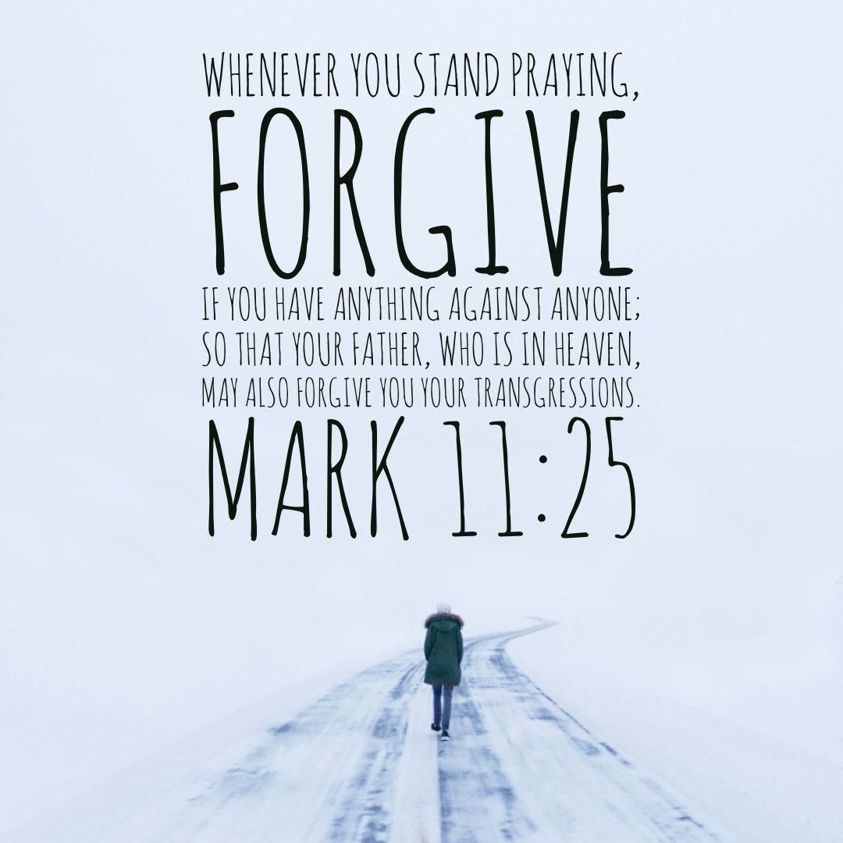

Slide 17
Matthew 18:21-35

Slide 18
“And be you kind one to another, tenderhearted, forgiving one another, even as God for Christ’s sake hath forgiven you” (Eph. 4:32). “Forbearing one another, and forgiving one another, if any man have a quarrel against any: even as Christ forgave you, so also do you” (Col. 3:13)

Slide 19
Who do you need to forgive? Whom do you need to seek forgiveness from? Will you meet the challenge to forgive as Christ forgave?

