Slide 3
Time, Talents, Praise, & Love

Slide 4
1 Therefore I urge you, brethren, by the mercies of God, to present your bodies a living and holy sacrifice, acceptable to God, which is your spiritual service of worship. 2 And do not be conformed to this world, but be transformed by the renewing of your mind, so that you may prove what the will of God is, that which is good and acceptable and perfect. (Romans 12:1-2)

Slide 6
1. Time

Slide 7
14 For this reason it says, “Awake, sleeper, And arise from the dead, And Christ will shine on you.” 15 Therefore be careful how you walk, not as unwise men but as wise, 16 making the most of your time, because the days are evil. 17 So then do not be foolish, but understand what the will of the Lord is. (Ephesians 5:14-17)

Slide 10
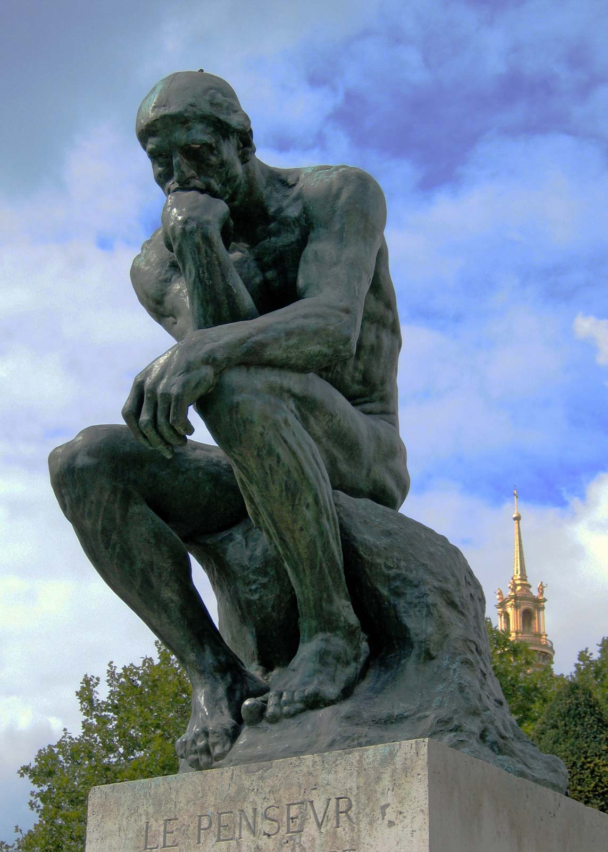

Slide 11
10 For we are His workmanship, created in Christ Jesus for good works, which God prepared beforehand so that we would walk in them. (Ephesians 2:10)

Slide 12
So how can we give our time as Christ did?

Slide 13
2. Talents/Abilities

Slide 14
Ephesians 4:4-8

Slide 15
Romans 12:3-8

Slide 16
How then do we discover our gifts, talents, and abilities so we can meet the challenge to give as Christ gave?

Slide 20
3. Praise/Thanks in everything give thanks; for this is God’s will for you in Christ Jesus. (1 Thessalonians 5:18)

Slide 21
1 Therefore I urge you, brethren, by the mercies of God, to present your bodies a living and holy sacrifice, acceptable to God, which is your spiritual service of worship. 2 And do not be conformed to this world, but be transformed by the renewing of your mind, so that you may prove what the will of God is, that which is good and acceptable and perfect. (Romans 12:1-2)

Slide 22
Luke 16:1-13

Slide 23
Will you meet the challenge to give as Christ gave? It requires your heart and your life. Will you give it in faith and obedience to God? Will you meet the challenge?

