Slide 3
40 “A ﻿pupil is not above his teacher; but everyone, after he has been fully trained, will ﻿be like his teacher. (John 6:40)

Slide 4
How many of us want the same confidence of Jesus in our walk with God? To know that we are doing God’s will as we should be? To express our love in obedience?

Slide 5
8 Although He was a Son, He learned obedience from the things which He suffered. 9 And having been made perfect, He became to all those who obey Him the source of eternal salvation, 10 being designated by God as a high priest according to the order of Melchizedek. (Hebrews 5:8-10)

Slide 6
12 So then, my beloved, just as you have always obeyed, not as in my presence only, but now much more in my absence, work out your salvation with fear and trembling; 13 for it is God who is at work in you, both to will and to work for His good pleasure. (Philippians 2:12-13)

Slide 7
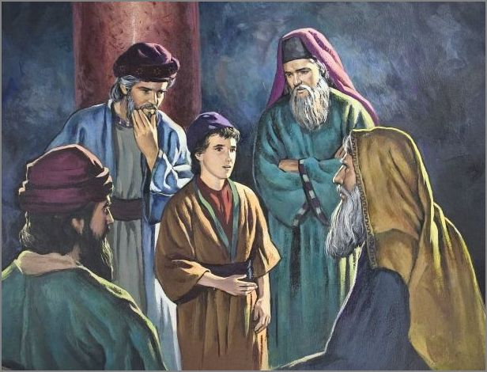
Luke 2:48-52

Slide 8
Matthew 3:13-17

Slide 9
3 Or do you not know that all of us who have been baptized into Christ Jesus have been baptized into His death? 4 Therefore we have been buried with Him through baptism into death, so that as Christ was raised from the dead through the glory of the Father, so we too might walk in newness of life. 5 For if we have become united with Him in the likeness of His death, certainly we shall also be in the likeness of His resurrection, (Romans 6:3-5)

Slide 10
17 But thanks be to God that though you were slaves of sin, you became obedient from the heart to that form of teaching to which you were committed, 18 and having been freed from sin, you became slaves of righteousness. (Romans 6:17-18)

Slide 11
Obedience In Service/Sacrifice

Slide 12
43 “But it is not this way among you, but whoever wishes to become great among you shall be your servant; 44 and whoever wishes to be first among you shall be slave of all. 45 “For even the Son of Man did not come to be served, but to serve, and to give His life a ransom for many.” (Mark 10:43-45)

Slide 13
John 13:12-17

Slide 14
20 Now the God of peace, who brought up from the dead the great Shepherd of the sheep through the blood of the eternal covenant, even Jesus our Lord, 21 equip you in every good thing to do His will, working in us that which is pleasing in His sight, through Jesus Christ, to whom be the glory forever and ever. Amen. (Hebrews 13:20-21)

Slide 15
“Lord, make me perfect in every good work to do Your will. Work in me that which is well-pleasing in Your sight. To follow Christ in obedience and please do it through Jesus Christ and may He receive the glory.”

Slide 16
8 Although He was a Son, He learned obedience from the things which He suffered. 9 And having been made perfect, He became to all those who obey Him the source of eternal salvation, 10 being designated by God as a high priest according to the order of Melchizedek. (Hebrews 5:8-10)

