Slide 3
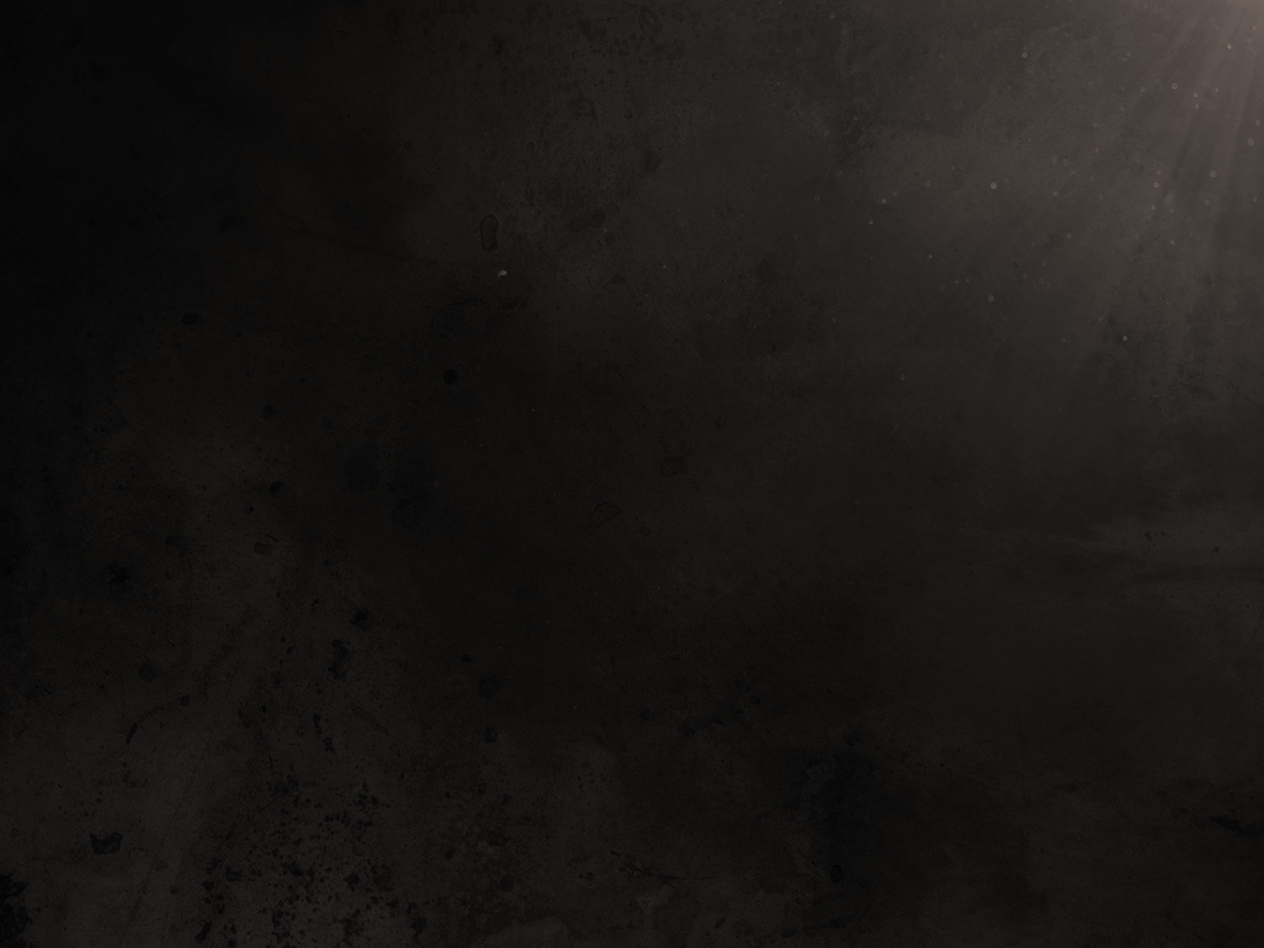
1 Therefore if you have been raised up with Christ, keep seeking the things above, where Christ is, seated at the right hand of God. 2 Set your mind on the things above, not on the things that are on earth. 3 For you have died and your life is hidden with Christ in God. (Colossians 3:1-3)

Slide 4
How do we look at others with the same thoughts of Jesus?
What about our own circumstances? How do we think of them in the way Christ would?
How do we focus on God’s will over our own?
How do we think like God?

Slide 5
10 “For this is the covenant that I will make with the house of Israel
After those days, says the Lord:
I will put My laws into their minds,
And I will write them on their hearts.
And I will be their God,
And they shall be My people.
(Hebrews 8:10)

Slide 6
18 But we all, with unveiled face, beholding as in a mirror the glory of the Lord, are being transformed into the same image from glory to glory, just as from the Lord, the Spirit.
(2 Corinthians 3:18)

Slide 7
2 Peter 1:1-4
Philippians 2:1-11

Slide 8
To “have the mind of Christ” means to look at life from the Savior’s point of view, having His values and desires in mind. It means to think God’s thoughts and not think as the world thinks. This is the challenge we have been called to do.

Slide 9
40 “A ﻿pupil is not above his teacher; but everyone, after he has been fully trained, will ﻿be like his teacher.
(John 6:40)

