Slide 1
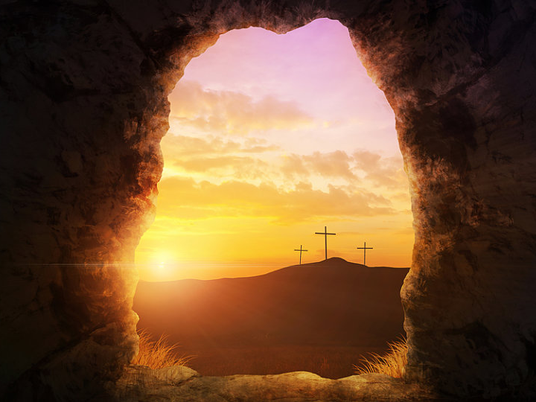
Christ Is Risen! John 20

Slide 2
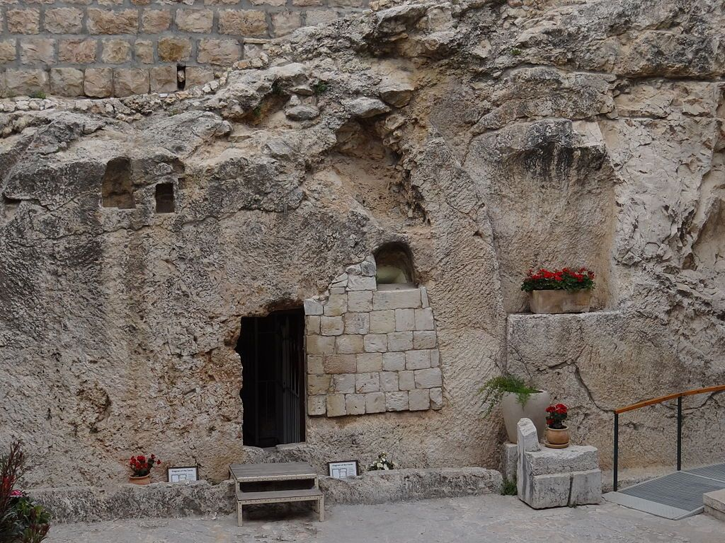
I. The Empty Tomb John 20:1-10

Slide 3
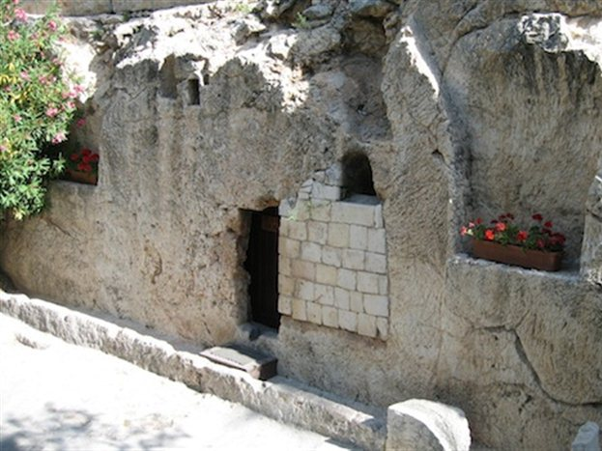

Slide 4
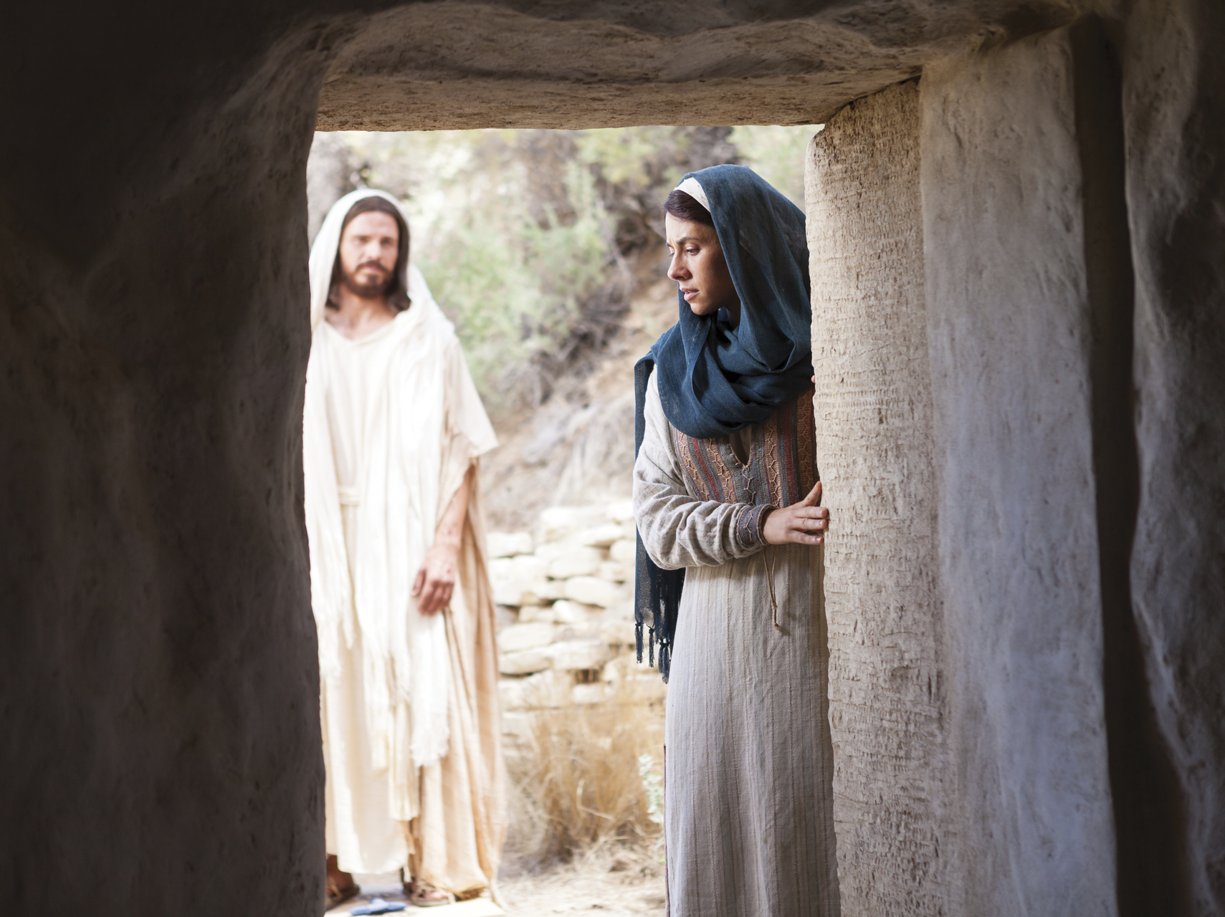
II. Mary Magdalene John 20:11-18

Slide 5
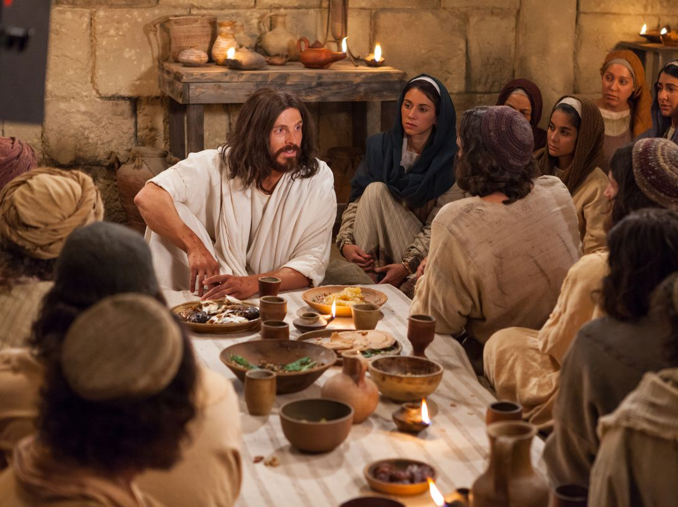
III. Two Sundays John 20:19-25

Slide 6
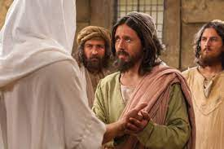
IV. Doubting Thomas John 20:26-29

Slide 7
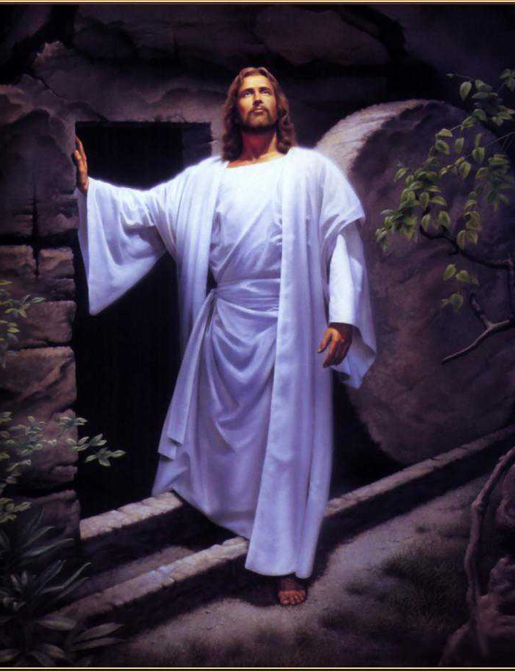
The Gospel
1 ﻿Now I make known to you, brethren, the gospel which I preached to you, which also you received, in which also you stand, 2 by which also you are saved, if you hold fast the word which I preached to you, unless you believed in vain. 3 ﻿For I delivered to you as of first importance what I also received, that Christ died for our sins according to the Scriptures, 4 and that He was buried, and that He was raised on the third day according to the Scriptures, 5 and that He appeared to Cephas, then to the twelve. (1 Corinthians 15:1-5)

