Slide 2
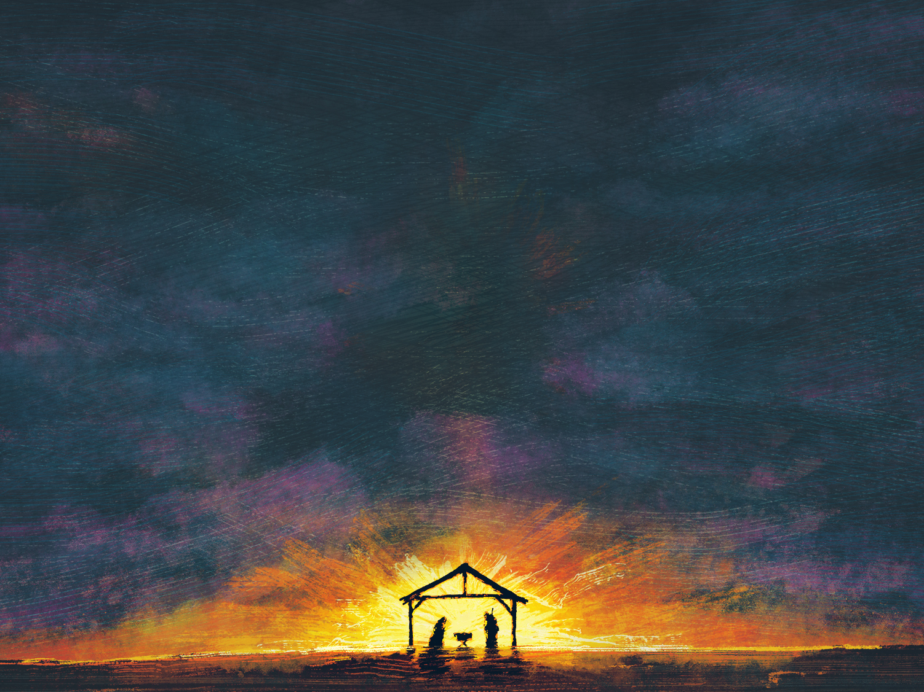
The Promise of John’s Birth
Luke 1:5-25

Slide 3
Gabriel Announces The Birth Of Jesus
Luke 1:26-38

Slide 4
Mary Visits Elizabeth
Luke 1:39-56

Slide 5
An Angel Visits Joseph
Matthew 1:18-25

Slide 6
The Birth of Jesus
Luke 2:1-7

Slide 7
The Shepherds Visit Jesus
Luke 2:8-20

Slide 8
Jesus Presented At The Temple
Luke 2:21-38

