Slide 1
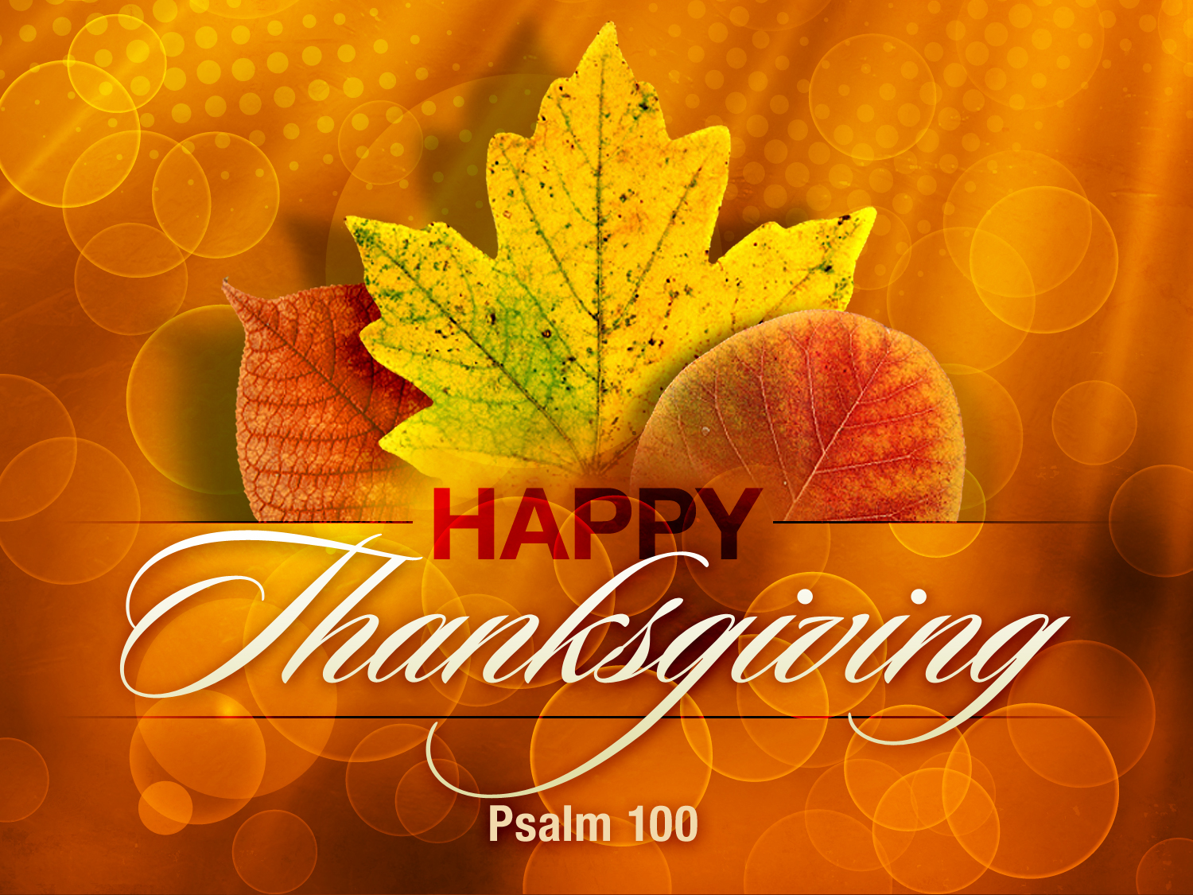

Slide 2

1. Thank God For His Goodness

Slide 3

4 Or do you think lightly of the riches of His kindness and tolerance and patience, not knowing that the kindness of God leads you to repentance? (Romans 2:4)

Slide 4
2. Thank God For His Love

Slide 5
16 “For God so loved the world, that He gave His only begotten Son, that whoever believes in Him shall not perish, but have eternal life. (John 3:16)

Slide 6

16 We have come to know and have believed the love which God has for us. God is love, and the one who abides in love abides in God, and God abides in him. 17 By this, love is perfected with us, so that we may have confidence in the day of judgment; because as He is, so also are we in this world.

Slide 7
18 There is no fear in love; but perfect love casts out fear, because fear involves punishment, and the one who fears is not perfected in love. 19 We love, because He first loved us. (1 John 4:16-19)

Slide 8
3. Thank God For His Gift

Slide 9
15 Thanks be to God for His indescribable gift! (2 Corinthians 9:15)

Slide 10
9 But you are a chosen race, a royal priesthood, a holy nation, a people for God’s own possession, so that you may proclaim the excellencies of Him who has called you out of darkness into His marvelous light; 10 for you once were not a people, but now you are the people of God; you had not received mercy, but now you have received mercy. (1 Peter 2:9-10)

Slide 11
4. Thank God For His Blessings

Slide 12
3 Blessed be the God and Father of our Lord Jesus Christ, who has blessed us with every spiritual blessing in the heavenly places in Christ, (Ephesians 1:3)

Slide 13
5. Thank God For His Grace & Mercy

Slide 14
11 For the grace of God has appeared, bringing salvation to all men, 12 instructing us to deny ungodliness and worldly desires and to live sensibly, righteously and godly in the present age (Titus 2;11-12)

Slide 15
6. Thank God For His Blessings

Slide 16
4 For by these He has granted to us His precious and magnificent promises, so that by them you may become partakers of the divine nature, having escaped the corruption that is in the world by lust.
(2 Peter 1:4)

Slide 17
20 For as many as are the promises of God, in Him they are yes; therefore also through Him is our Amen to the glory of God through us. (2 Corinthians 1:20)

Slide 18
7. Thank God For His Word

Slide 19
16 All Scripture is inspired by God and profitable for teaching, for reproof, for correction, for training in righteousness; 17 so that the man of God may be adequate, equipped for every good work.
(2 Timothy 3:16-17)

Slide 20
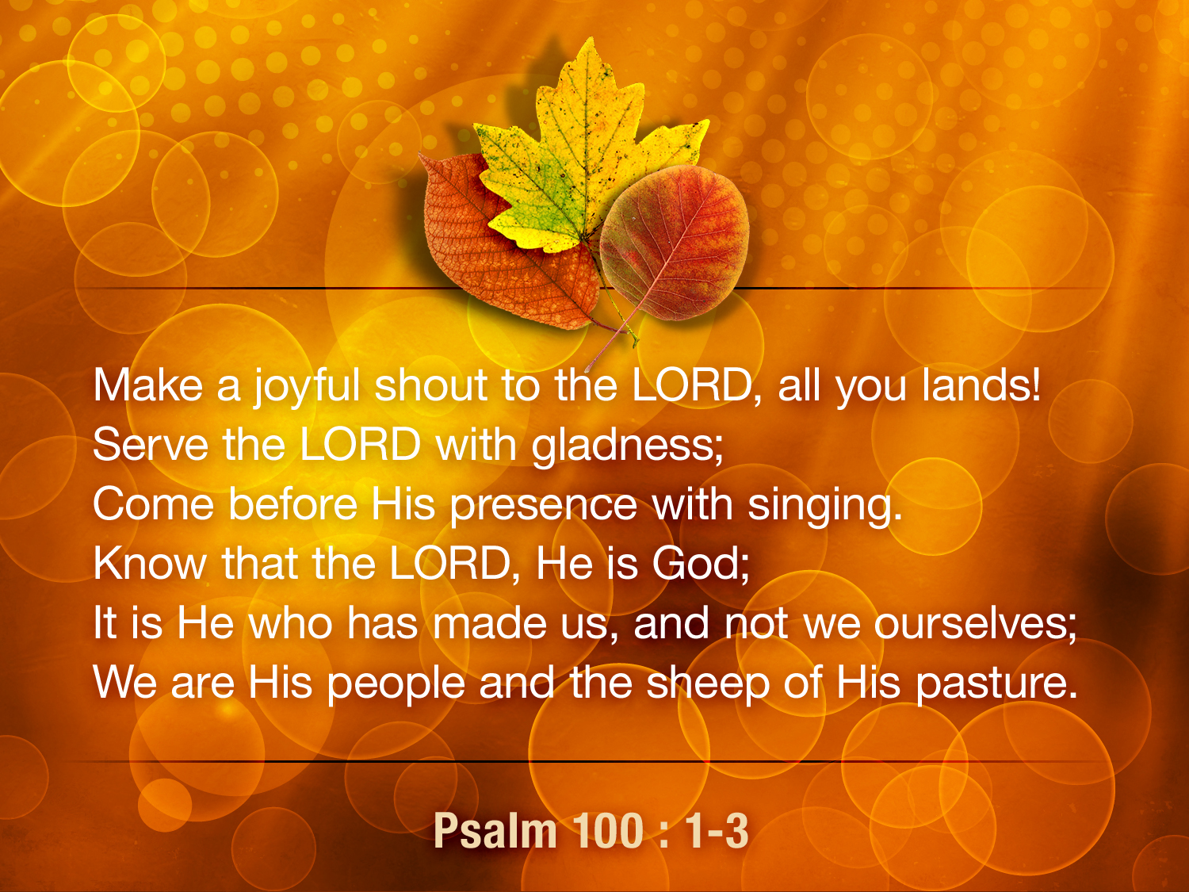

Slide 21
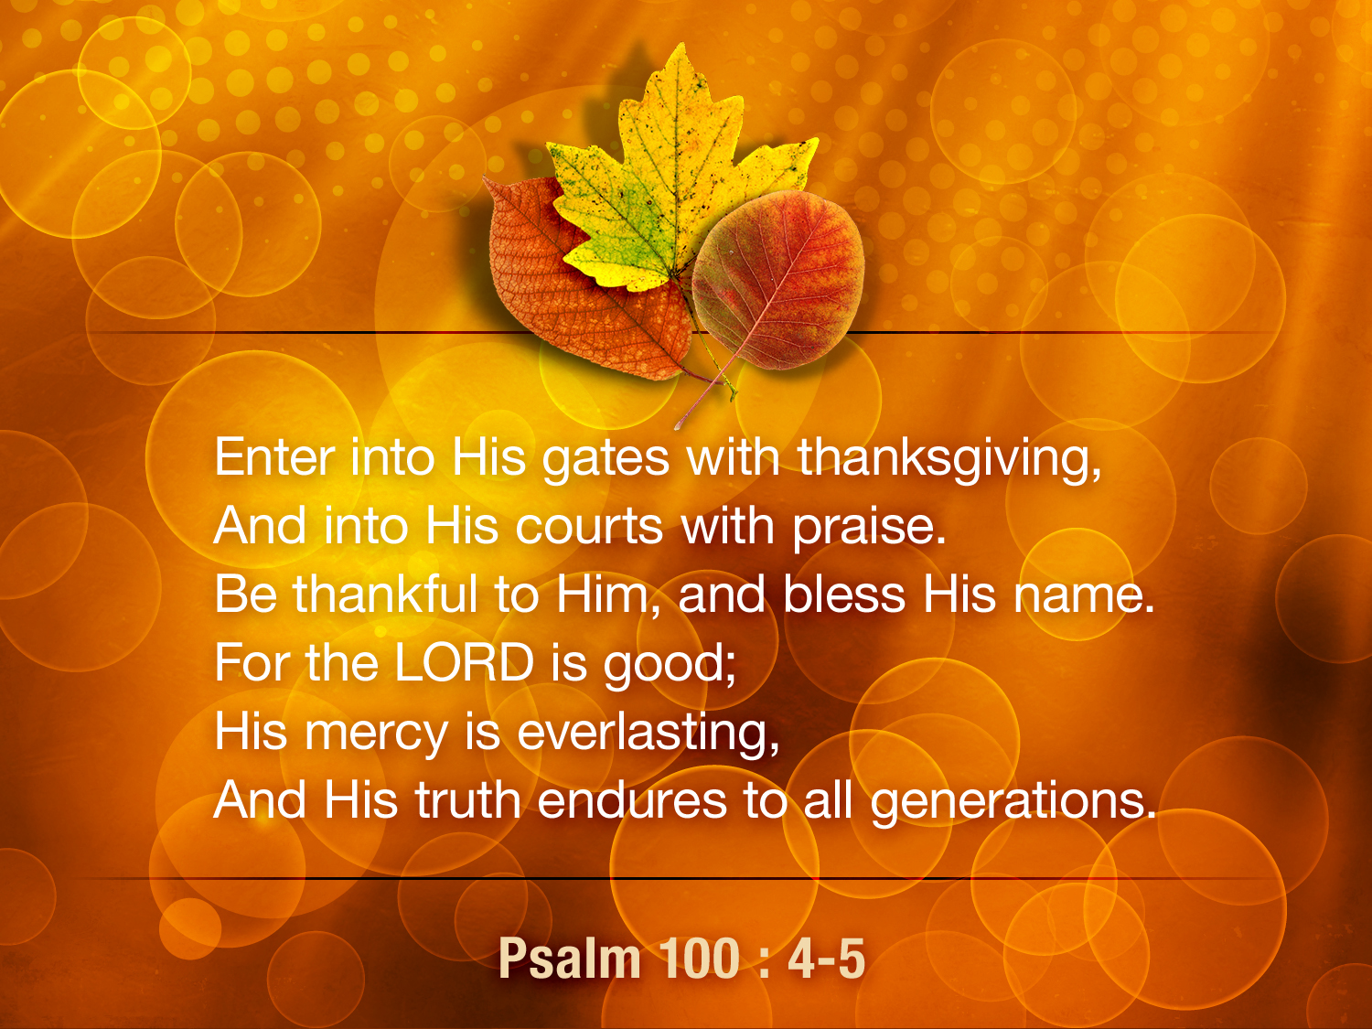

Slide 22
11 And all the angels were standing around the throne and around the elders and the four living creatures; and they fell on their faces before the throne and worshiped God,
12 saying, “Amen, blessing and glory and wisdom and thanksgiving and honor and power and might, be to our God forever and ever. Amen.” (Revelation 7:11-12)

