Slide 3
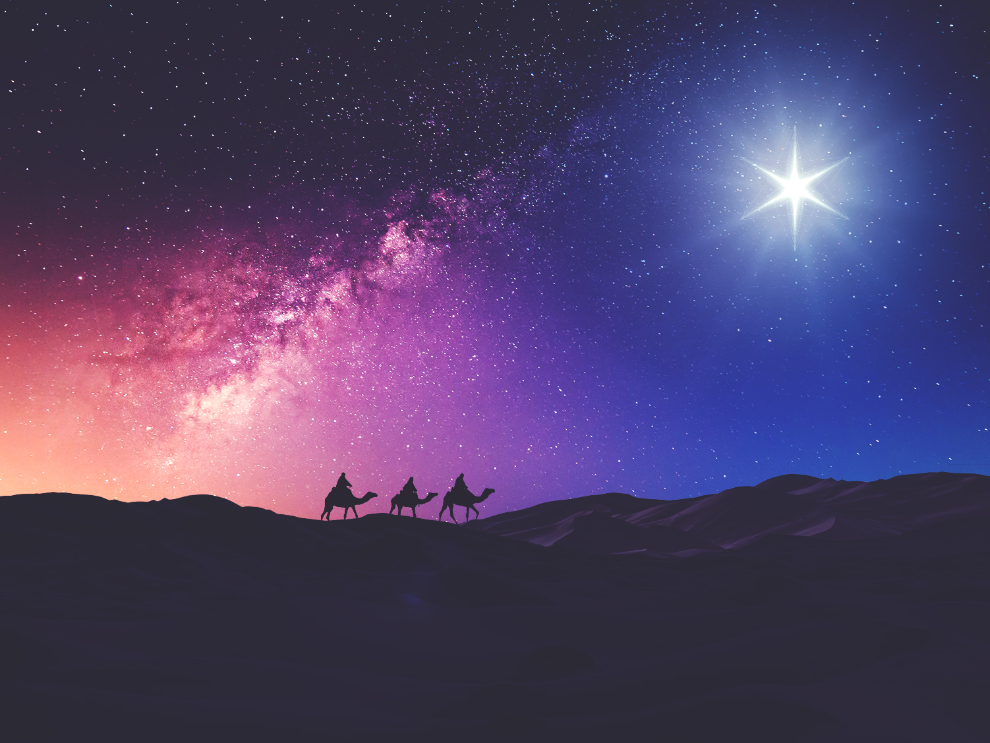
1. It is wise to have Jesus in your house

Slide 4
24 “Therefore everyone who hears these words of Mine and acts on them, may be compared to a wise man who built his house on the rock. 25 “And the rain fell, and the floods came, and the winds blew and slammed against that house; and yet it did not fall, for it had been founded on the rock.

Slide 5
26 “Everyone who hears these words of Mine and does not act on them, will be like a foolish man who built his house on the sand. 27 “The rain fell, and the floods came, and the winds blew and slammed against that house; and it fell—and great was its fall.” (Matthew 7:24-27)

Slide 6
2. It is wise to worship
Jesus in your house

Slide 7
23 Sing to the Lord, all the earth; Proclaim good tidings of His salvation from day to day. (1 Chronicles 16:23) 16 Let all who seek You rejoice and be glad in You; Let those who love Your salvation say continually, “The Lord be magnified!” (Psalm 40:16)

Slide 8
4 “Hear, O Israel! The Lord is our God, the Lord is one! 5 “You shall love the Lord your God with all your heart and with all your soul and with all your might. 6 “These words, which I am commanding you today, shall be on your heart.

Slide 9
7 “You shall teach them diligently to your sons and shall talk of them when you sit in your house and when you walk by the way and when you lie down and when you rise up. 8 “You shall bind them as a sign on your hand and they shall be as frontals on your forehead. 9 “You shall write them on the doorposts of your house and on your gates. (Deuteronomy 6:4-9)

Slide 10
3. It is wise to recognize
Jesus as Lord in your house

Slide 11
37 And He said to him, “ ‘You shall love the Lord your God with all your heart, and with all your soul, and with all your mind.’ 38 “This is the great and foremost commandment. 39 “The second is like it, ‘You shall love your neighbor as yourself.’ 40 “On these two commandments depend the whole Law and the Prophets.” (Matthew 22:37-40)

Slide 12
25 Therefore He is able also to save forever those who draw near to God through Him, since He always lives to make intercession for them. (Hebrews 7:25)

