Slide 2
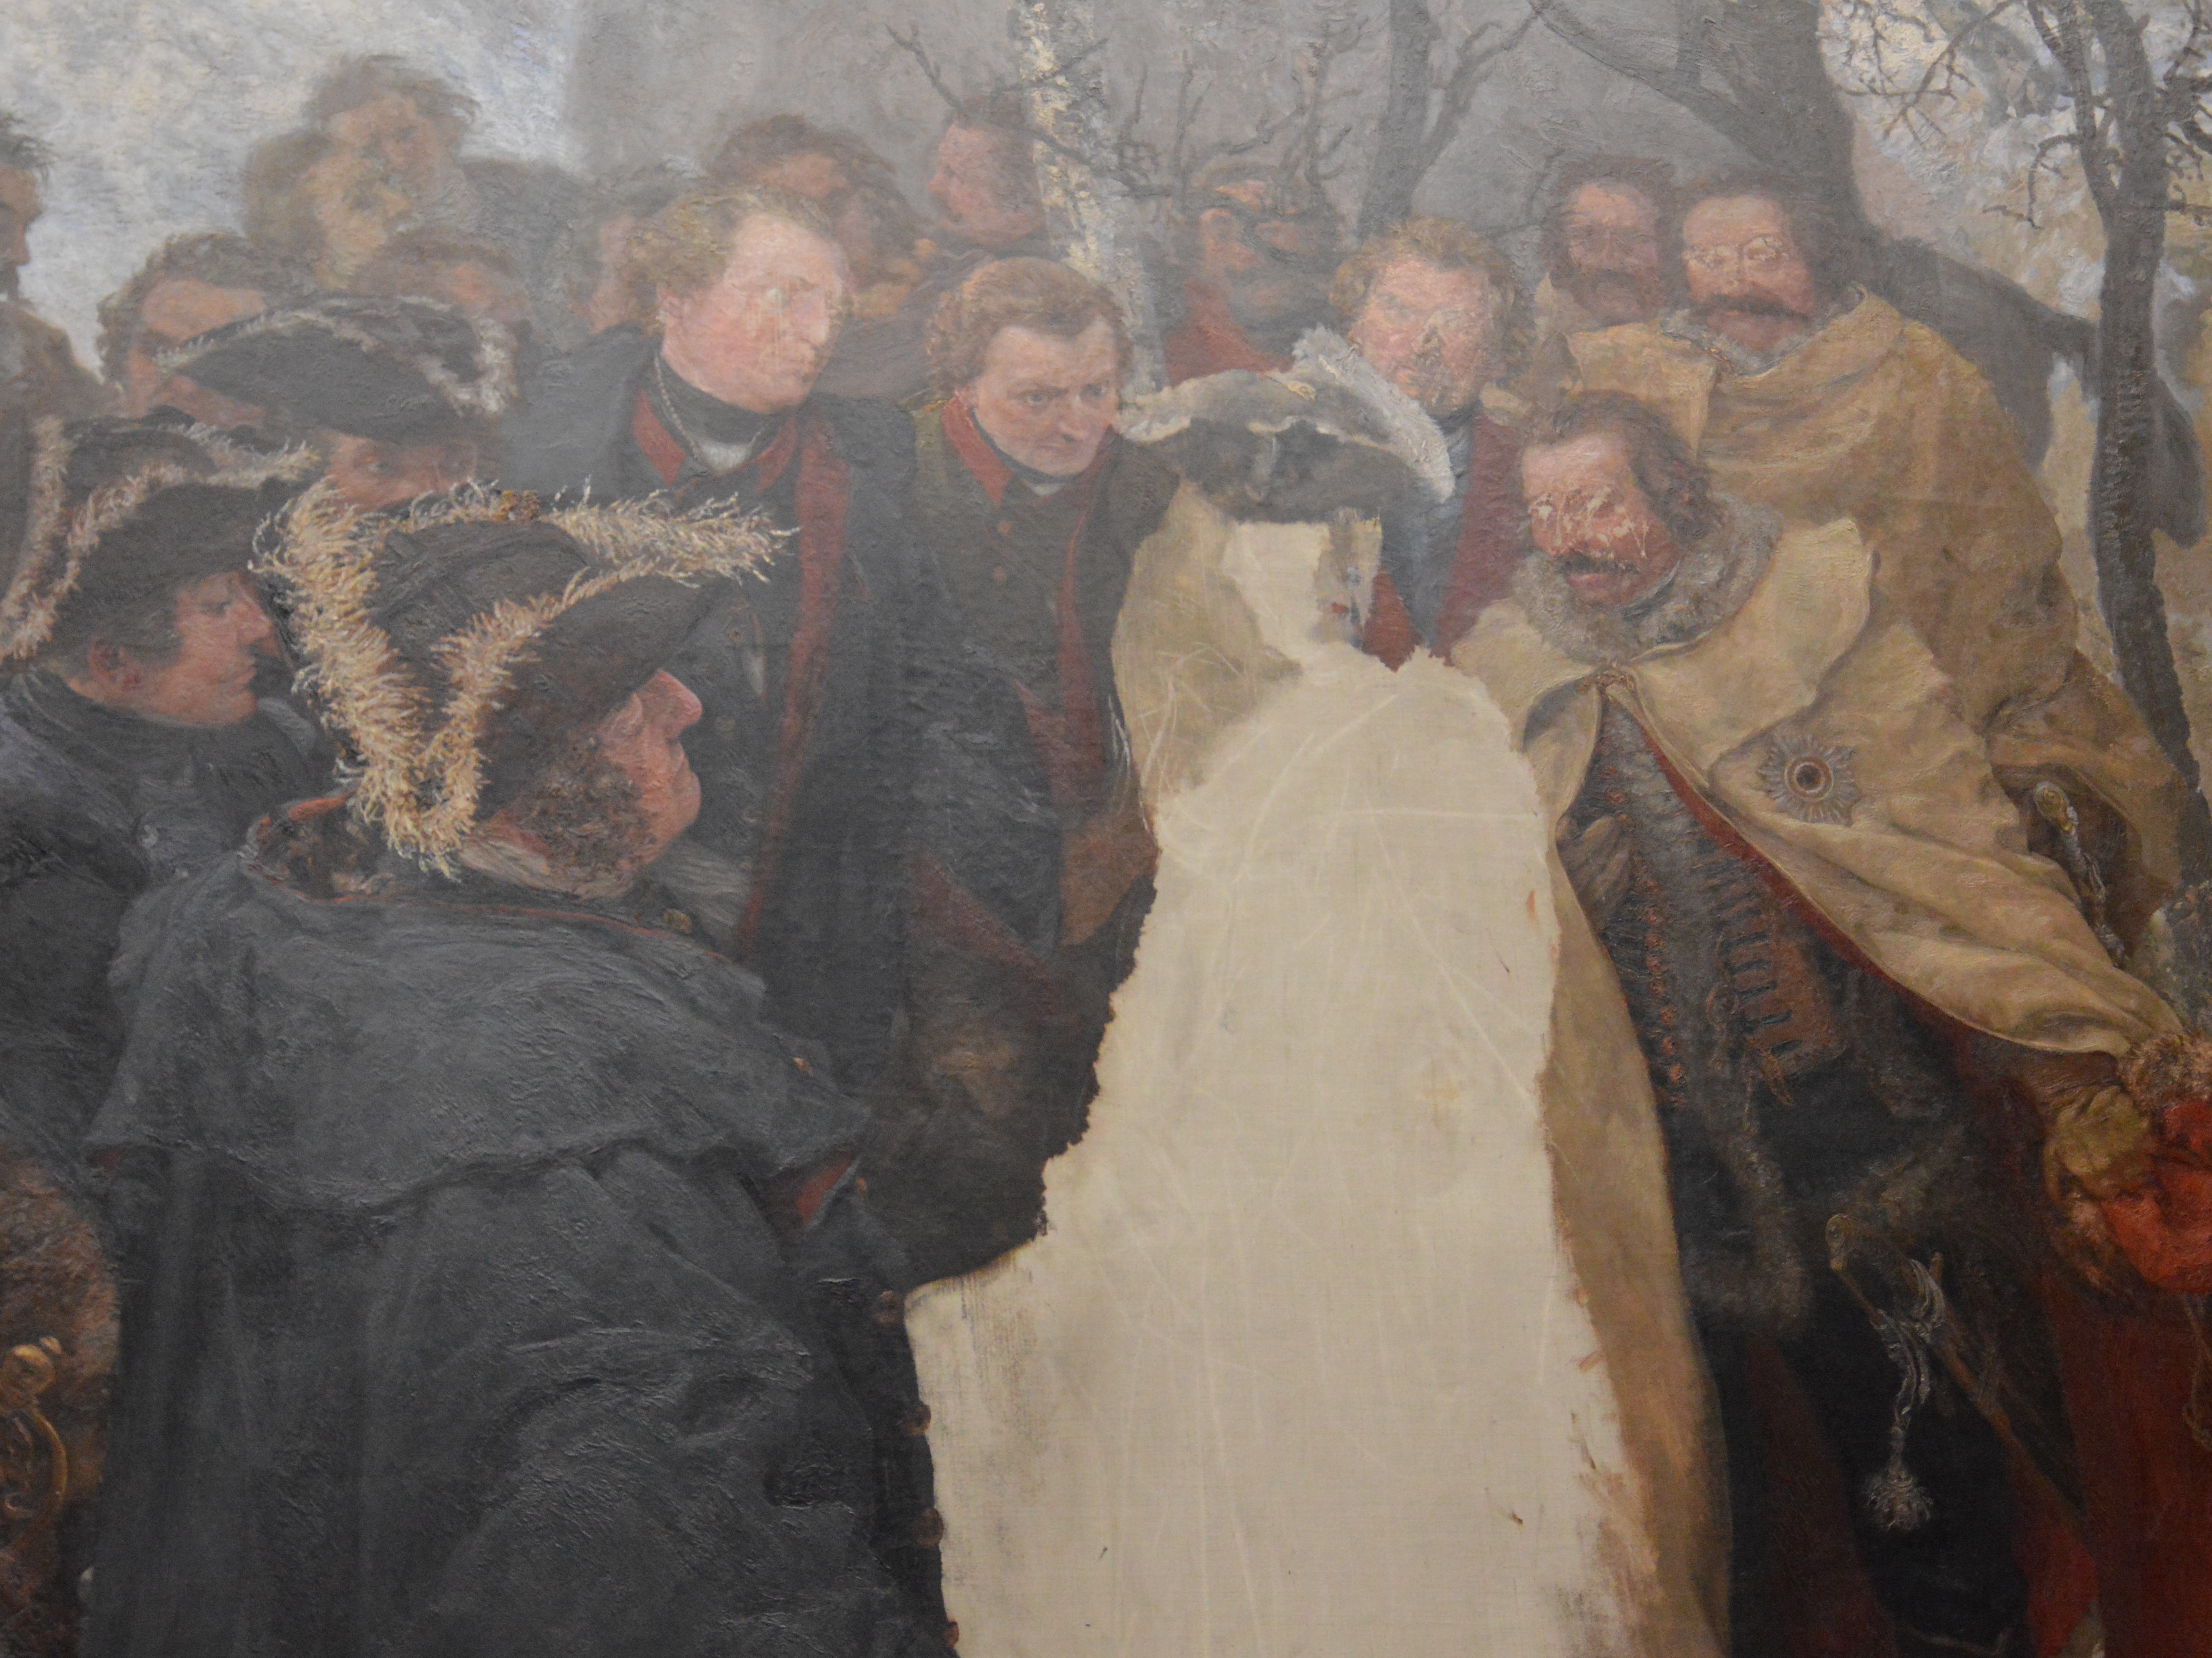

Slide 3
1. Give God the FIRST hour each day

Slide 4
“Planned Neglect”

Slide 5
2 But his delight is in the law of the Lord, And in His law he meditates day and night. (Psalm 1:2)

Slide 6
1 First of all, then, I urge that entreaties and prayers, petitions and thanksgivings, be made on behalf of all men, (1 Timothy 2:1)

Slide 7
2. Give God the FIRST day of each week

Slide 8
7 On the first day of the week, when we were gathered together to break bread (Acts 20:7a)

Slide 9
23 For I received from the Lord that which I also delivered to you, that the Lord Jesus in the night in which He was betrayed took bread; 24 and when He had given thanks, He broke it and said, “This is My body, which is for you; do this in remembrance of Me.”

Slide 10
25 In the same way He took the cup also after supper, saying, “This cup is the new covenant in My blood; do this, as often as you drink it, in remembrance of Me.” 26 For as often as you eat this bread and drink the cup, you proclaim the Lord’s death until He comes. (1 Corinthians 11:23-26)

Slide 11
11 “Worthy are You, our Lord and our God, to receive glory and honor and power; for You created all things, and because of Your will they existed, and were created.” (Revelation 4:11)

Slide 12
Revelation 5:11-14

Slide 13
24 and let us consider how to stimulate one another to love and good deeds, 25 not forsaking our own assembling together, as is the habit of some, but encouraging one another; and all the more as you see the day drawing near. (Hebrews 10:24-25)

Slide 14
3. Give God the FIRST portion of your pay

Slide 15
9 Honor the Lord from your wealth And from the first of all your produce; 10 So your barns will be filled with plenty And your vats will overflow with new wine. (Proverbs 3:9-10)

Slide 16
4. Give God the FIRST consideration in every decision

Slide 17
5. Give God the FIRST place in your heart

Slide 18
28 One of the scribes came and heard them arguing, and recognizing that He had answered them well, asked Him, “What commandment is the foremost of all?” 29 Jesus answered, “The foremost is, ‘Hear, O Israel! The Lord our God is one Lord; 30 and you shall love the Lord your God with all your heart, and with all your soul, and with all your mind, and with all your strength.’ (Mark 12:28-30)

Slide 19
1 Therefore if you have been raised up with Christ, keep seeking the things above, where Christ is, seated at the right hand of God. 2 Set your mind on the things above, not on the things that are on earth. 3 For you have died and your life is hidden with Christ in God. 4 When Christ, who is our life, is revealed, then you also will be revealed with Him in glory. (Colossians 3:1-4)

Slide 20
1. Give God the FIRST hour of each day 2. Give God the FIRST day of each week 3. Give God the FIRST portion of your pay 4. Give God the FIRST consideration in every decision 5. Give God the FIRST place in your heart

