Slide 2
Come, bless God, all you servants of God! You priests of God, posted to the nightwatch in God’s shrine,
- Psalm 134

Slide 3
Lift your praising hands to the Holy Place, and bless God. In turn, may God of Zion bless you— God who made heaven and earth!
- Psalm 134

Slide 4
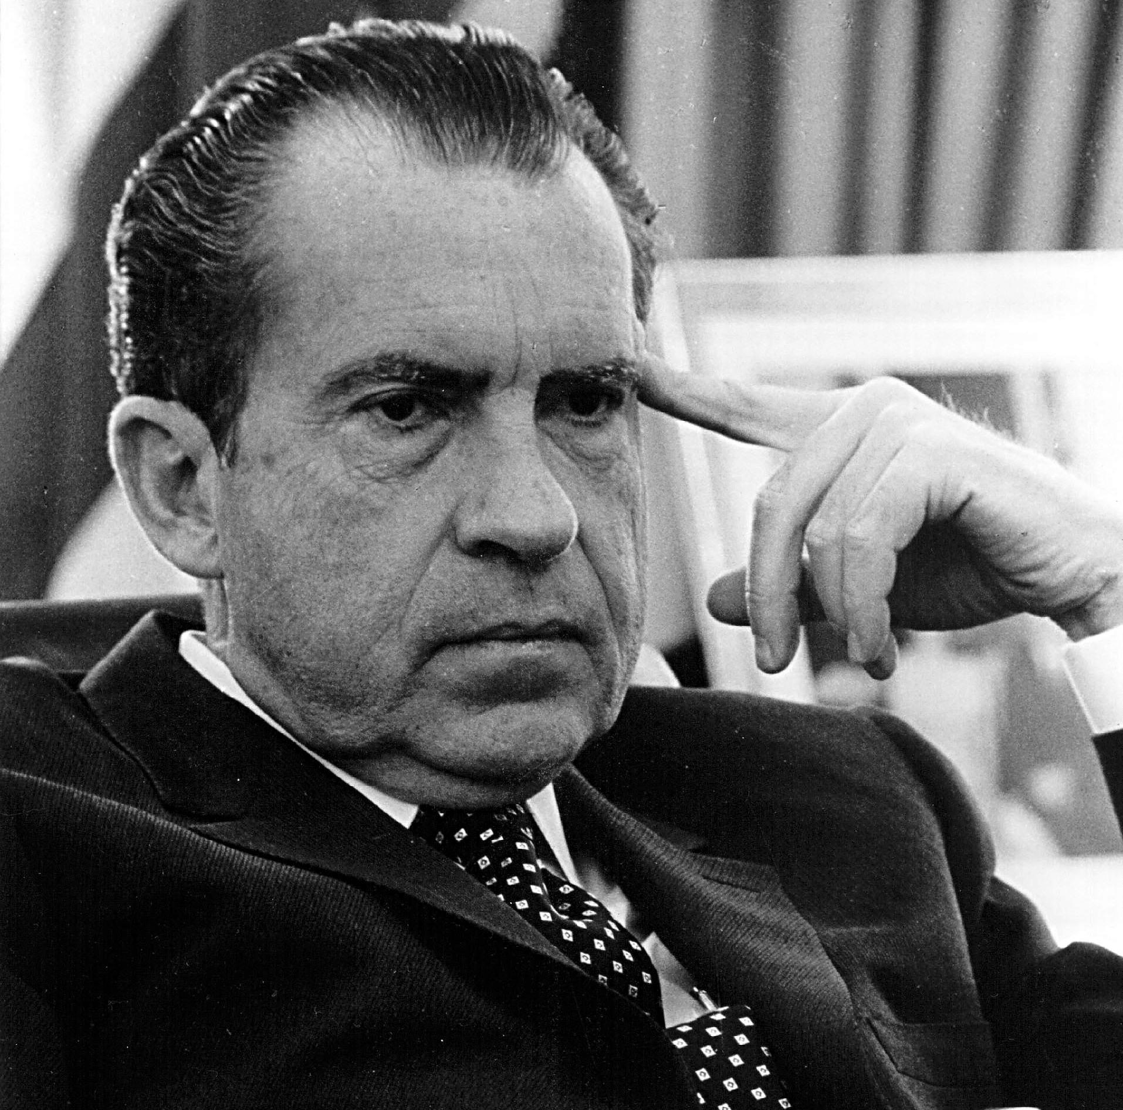

Slide 5
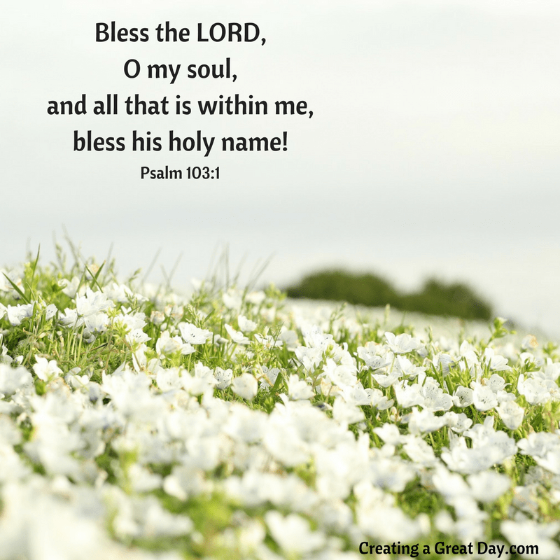
I. Stand, Stoop, Stay

Slide 6
II. An Invitation & A Command

Slide 7
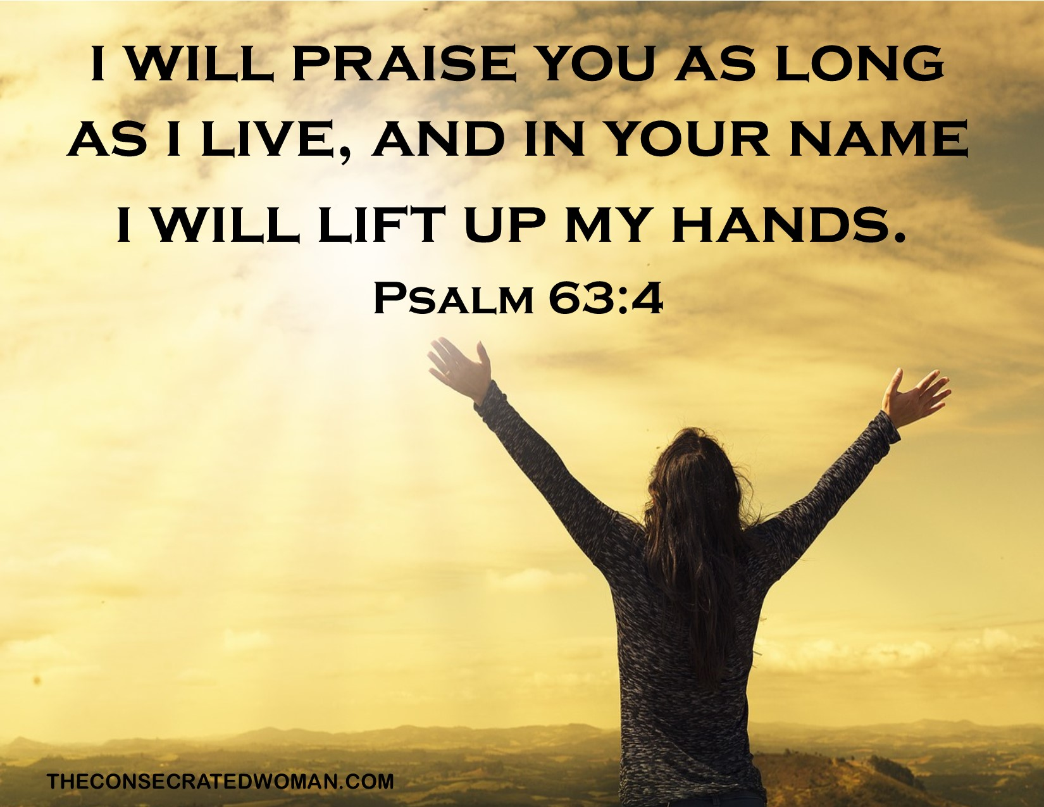
III. Feelings Don’t Run The Show

