Slide 2
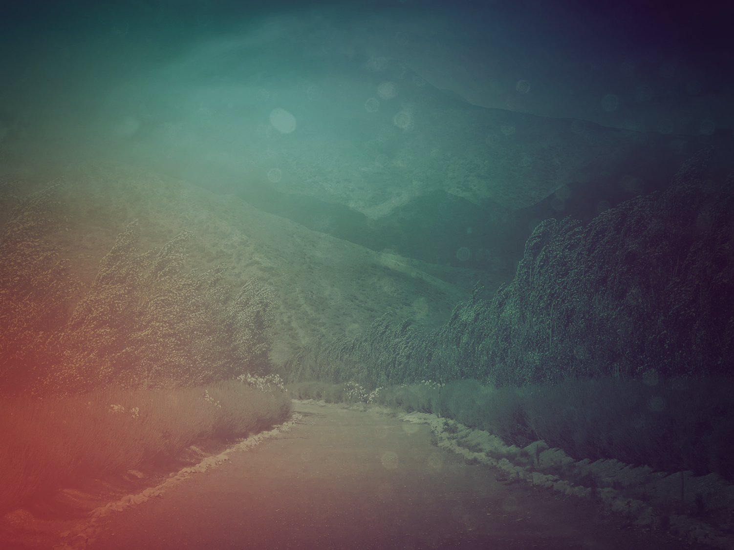
Those who trust in GOD are like Zion Mountain:
Nothing can move it, a rock-solid mountain you can always depend on.
- Psalm 125

Slide 3
Mountains encircle Jerusalem, and GOD encircles his people— always has and always will.
- Psalm 125

Slide 4
The fist of the wicked will never violate
What is due the righteous, provoking wrongful violence.
- Psalm 125

Slide 5
Be good to your good people, GOD, to those whose hearts are right!
GOD will round up the backsliders, corral them with the incorrigibles.
Peace over Israel!
- Psalm 125

Slide 7
I. Secure In the Fortress

Slide 8
God is our refuge and strength,
A very present help in trouble. (Psalm 46:1)

Slide 9
II. The Seesaw History Of Israel

Slide 10
III. A Threatening Sword

Slide 11
IV. Secure In Christ

Slide 12
V. Mountain Climbers Roped Together

