Slide 2
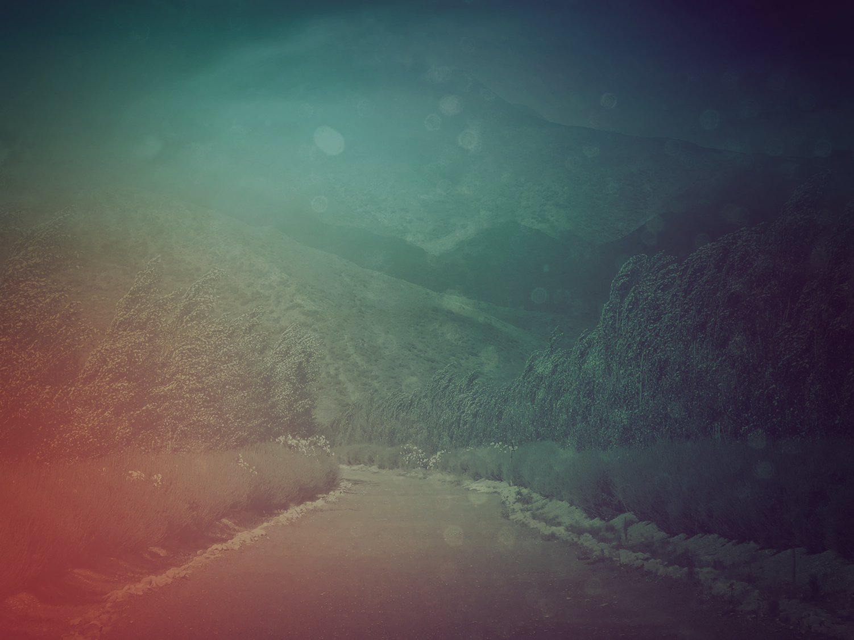
All you who fear GOD, how blessed you are! how happily you walk on his smooth straight road!
You worked hard and deserve all you’ve got coming.
Enjoy the blessing!
Revel in the goodness!
- Psalm 128

Slide 3
Your wife will bear children as a vine bears grapes, your household lush as a vineyard,
The children around your table as fresh and promising as young olive shoots.
- Psalm 128

Slide 4
Stand in awe of God’s Yes.
Oh, how he blesses the one who fears GOD!
- Psalm 128

Slide 5
Enjoy the good life in Jerusalem every day of your life.
And enjoy your grandchildren.
Peace to Israel!
- Psalm 128

Slide 6
I. Promises & Pronouncements

Slide 7
7 Blessings In Revelation
1:3 Blessed is he who reads and those who hear the words of the prophecy, and heed the things which are written in it; for the time is near.
14:13 And I heard a voice from heaven, saying, “Write, ‘Blessed are the dead who die in the Lord from now on!’ ” “Yes,” says the Spirit, “so that they may rest from their labors, for their deeds follow with them.”

Slide 8
7 Blessings In Revelation
16:15 (“Behold, I am coming like a thief. Blessed is the one who stays awake and keeps his clothes, so that he will not walk about naked and men will not see his shame.”)
19:9 Then he said to me, “Write, ‘Blessed are those who are invited to the marriage supper of the Lamb.’ ” And he said to me, “These are true words of God.”

Slide 9
7 Blessings In Revelation
20:6 Blessed and holy is the one who has a part in the first resurrection; over these the second death has no power, but they will be priests of God and of Christ and will reign with Him for a thousand years.
22:7 And behold, I am coming quickly. Blessed is he who heeds the words of the prophecy of this book.”

Slide 10
7 Blessings In Revelation
22:14 Blessed are those who wash their robes, so that they may have the right to the tree of life, and may enter by the gates into the city.

Slide 11
II. Sharing In Life

Slide 12
Do not love the world nor the things in the world. If anyone loves the world, the love of the Father is not in him. For all that is in the world, the lust of the flesh and the lust of the eyes and the boastful pride of life, is not from the Father, but is from the world. The world is passing away, and also its lusts; but the one who does the will of God lives forever.
( 1 John 2:15-17)

Slide 13
For whatever is born of God overcomes the world; and this is the victory that has overcome the world—our faith. Who is the one who overcomes the world, but he who believes that Jesus is the Son of God? (1 John 5:4-5)

Slide 14
III. Traveling By The Roads

