Slide 2
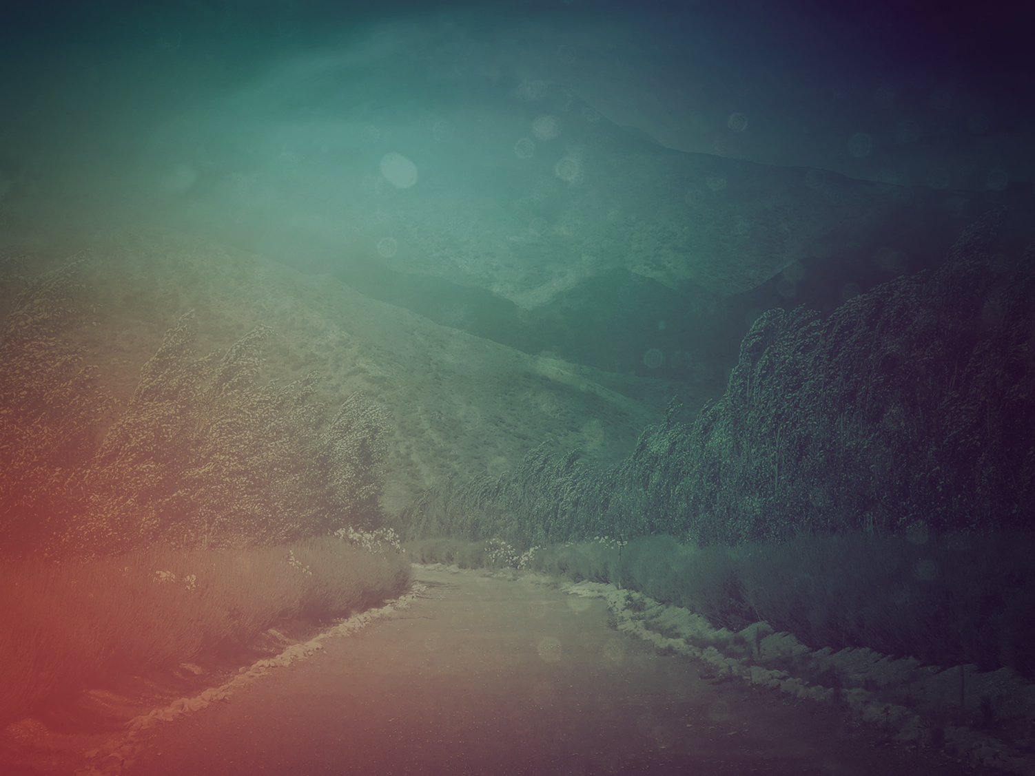
If GOD hadn’t been for us
—all together now, Israel, sing out!—
If GOD hadn’t been for us when everyone went against us,
We would have been swallowed alive by their violent anger,
- Psalm 124

Slide 3
Swept away by the flood of rage, drowned in the torrent;
We would have lost our lives in the wild, raging water.
- Psalm 124

Slide 4
Oh, blessed be GOD!
He didn’t go off and leave us.
He didn’t abandon us defenseless, helpless as a rabbit in a pack of snarling dogs.
- Psalm 124

Slide 5
We’ve flown free from their fangs, free of their traps, free as a bird.
Their grip is broken; we’re free as a bird in flight.
- Psalm 124

Slide 6
GOD’s strong name is our help, the same GOD who made heaven and earth.
- Psalm 124

Slide 8
I. A Clerk
In The Complaints Department

Slide 10
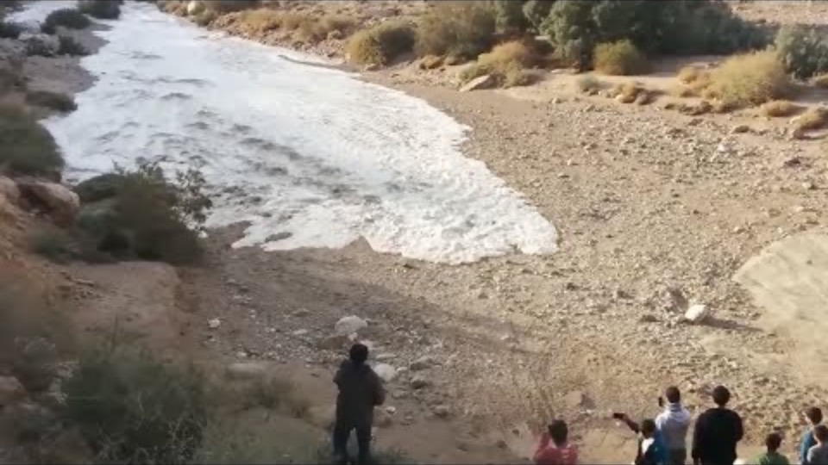

Slide 12
II. Hazardous Work

Slide 13
III. Zoomed In 100x

