Slide 1
3
Paul's Teaching on Perfection

Slide 2
Review
Conditional Perfection Perfection imputed on man by God based on faith in Christ.

Slide 3
Review
Conditional Perfection
Actual Perfection The ideal we pursue to express our faith and honor God.

Slide 4
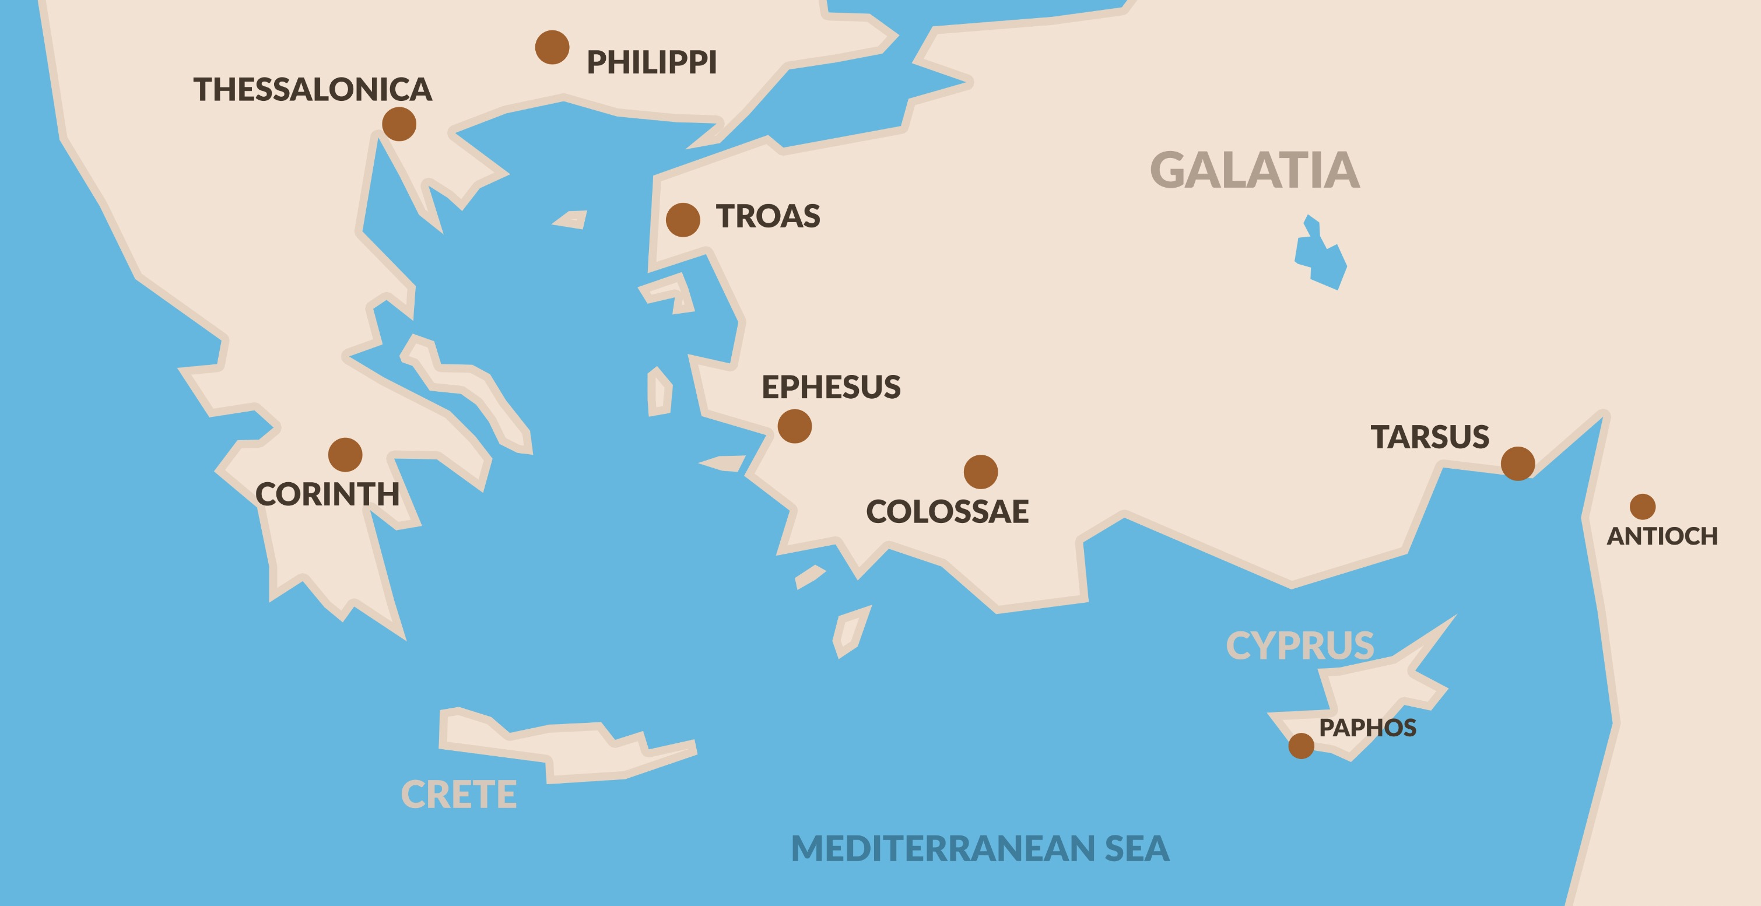
Galatians
Church established in Asia Minor by Paul

Slide 5
Galatians
Church established in Asia Minor by Paul
Were being influenced by false teachers
Some were considering abandoning the gospel as a results

Slide 6
⁶ I am amazed that you are so quickly deserting Him who called you by the grace of Christ, for a different gospel; ⁷ which is really not another; only there are some who are disturbing you and want to distort the gospel of Christ.
- Galatians 1:6-7

Slide 7
But even if we, or an angel from heaven, should preach to you a gospel contrary to what we have preached to you, he is to be accursed!
- Galatians 1:8

Slide 8
¹¹ For I would have you know, brethren, that the gospel which was preached by me is not according to man. ¹² For I neither received it from man, nor was I taught it, but I received it through a revelation of Jesus Christ.
- Galatians 1:11-12

Slide 9
¹³ The rest of the Jews joined him in hypocrisy, with the result that even Barnabas was carried away by their hypocrisy. ¹⁴ But when I saw that they were not straightforward about the truth of the gospel, I said to Cephas in the presence of all, “If you, being a Jew, live like the Gentiles and not like the Jews, how is it that you compel the Gentiles to live like Jews?
- Galatians 2:13-14

Slide 10
¹⁵ “We are Jews by nature and not sinners from among the Gentiles; ¹⁶ nevertheless knowing that a man is not justified by the works of the Law but through faith in Christ Jesus, even we have believed in Christ Jesus, so that we may be justified by faith in Christ and not by the works of the Law; since by the works of the Law no flesh will be justified.
- Galatians 2:15-16

Slide 11
²⁶ For you are all sons of God through faith in Christ Jesus. ²⁷ For all of you who were baptized into Christ have clothed yourselves with Christ.
- Galatians 3:26-27

Slide 12
Things People Do When they Come to Christ
Listen
Decide
Repent
Confess
Baptized
Remain faithful

Slide 13
These things are not works of the law because: 1. We can actually do these things 2. They are given to us to do by God 3. They are effective

Slide 14
PAUL POINTS OUT THE STAKES:
³ So also we, while we were children, were held in bondage under the elemental things of the world. ⁴ But when the fullness of the time came, God sent forth His Son, born of a woman, born under the Law, ⁵ so that He might redeem those who were under the Law, that we might receive the adoption as sons.
- Galatians 4:3-5

Slide 15
⁶ Because you are sons, God has sent forth the Spirit of His Son into our hearts, crying, “Abba! Father!” ⁷ Therefore you are no longer a slave, but a son; and if a son, then an heir through God.
- Galatians 4:6-7

Slide 16
PAUL’S WARNING
² Behold I, Paul, say to you that if you receive circumcision, Christ will be of no benefit to you. ³ And I testify again to every man who receives circumcision, that he is under obligation to keep the whole Law. ⁴ You have been severed from Christ, you who are seeking to be justified by law; you have fallen from grace.
- Galatians 5:2-4

Slide 17
Adhering to Rules is Tempting
It’s easier

Slide 18
Adhering to Rules is Tempting
It’s easier
Appeals to our pride

Slide 19
Adhering to Rules is Tempting
It’s easier
Appeals to our pride
It offers power over others

Slide 20
PURSUE ACTUAL PERFECTION
¹³ For you were called to freedom, brethren; only do not turn your freedom into an opportunity for the flesh, but through love serve one another. ¹⁴ For the whole Law is fulfilled in one word, in the statement, “You shall love your neighbor as yourself.”
- Galatians 5:13-14

Slide 21
¹⁵ But if you bite and devour one another, take care that you are not consumed by one another. ¹⁶ But I say, walk by the Spirit, and you will not carry out the desire of the flesh.
- Galatians 5:15-16

Slide 22
Summary
Paul is responding to Christians being seduced by false teachers

Slide 23
Summary
He is opposing a form of legalism

Slide 24
Summary
He condemns the false teachers

Slide 25
Summary
He reminds the Galatians:
The way they were saved

Slide 26
Summary
He reminds the Galatians:
The way they were saved
The message that saved them

Slide 27
Summary
He reminds the Galatians:
The way they were saved
The message that saved them
The messenger who brought the Good News

Slide 28
Summary
He reminds the Galatians:
The way they were saved
The message that saved them
The messenger who brought the Good News
Their status in Christ

Slide 29
Summary
He reminds the Galatians:
The way they were saved
The message that saved them
The messenger who brought the Good News
Their status in Christ
Their access and guarantee in Christ

Slide 30
Summary
He reminds the Galatians:
The way they were saved
The message that saved them
The messenger who brought the Good News
Their status in Christ
Their access and guarantee in Christ
The lifestyle of faith

