Slide 2
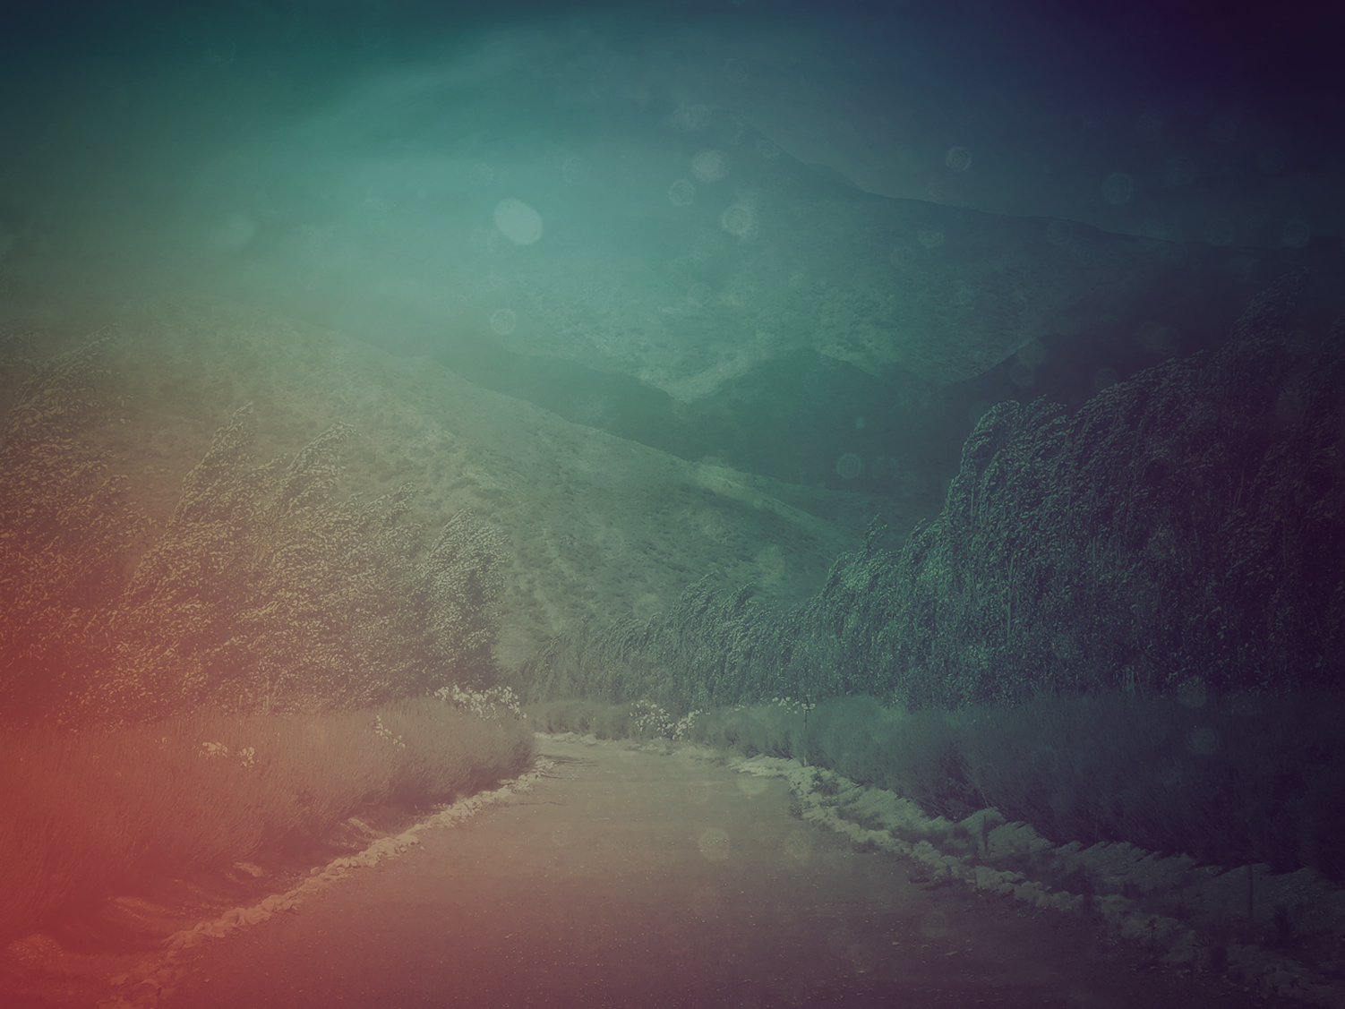
I look up to the mountains; does my strength come from mountains?
No, my strength comes from GOD, who made heaven, and earth, and mountains.
- Psalm 121

Slide 3
He won’t let you stumble, your Guardian God won’t fall asleep.
Not on your life! Israel’s
Guardian will never doze or sleep.
- Psalm 121

Slide 4
GOD’s your Guardian, right at your side to protect you—
Shielding you from sunstroke, sheltering you from moonstroke.
- Psalm 121

Slide 5
GOD guards you from every evil, he guards your very life.
He guards you when you leave and when you return, he guards you now, he guards you always.
- Psalm 121

Slide 8
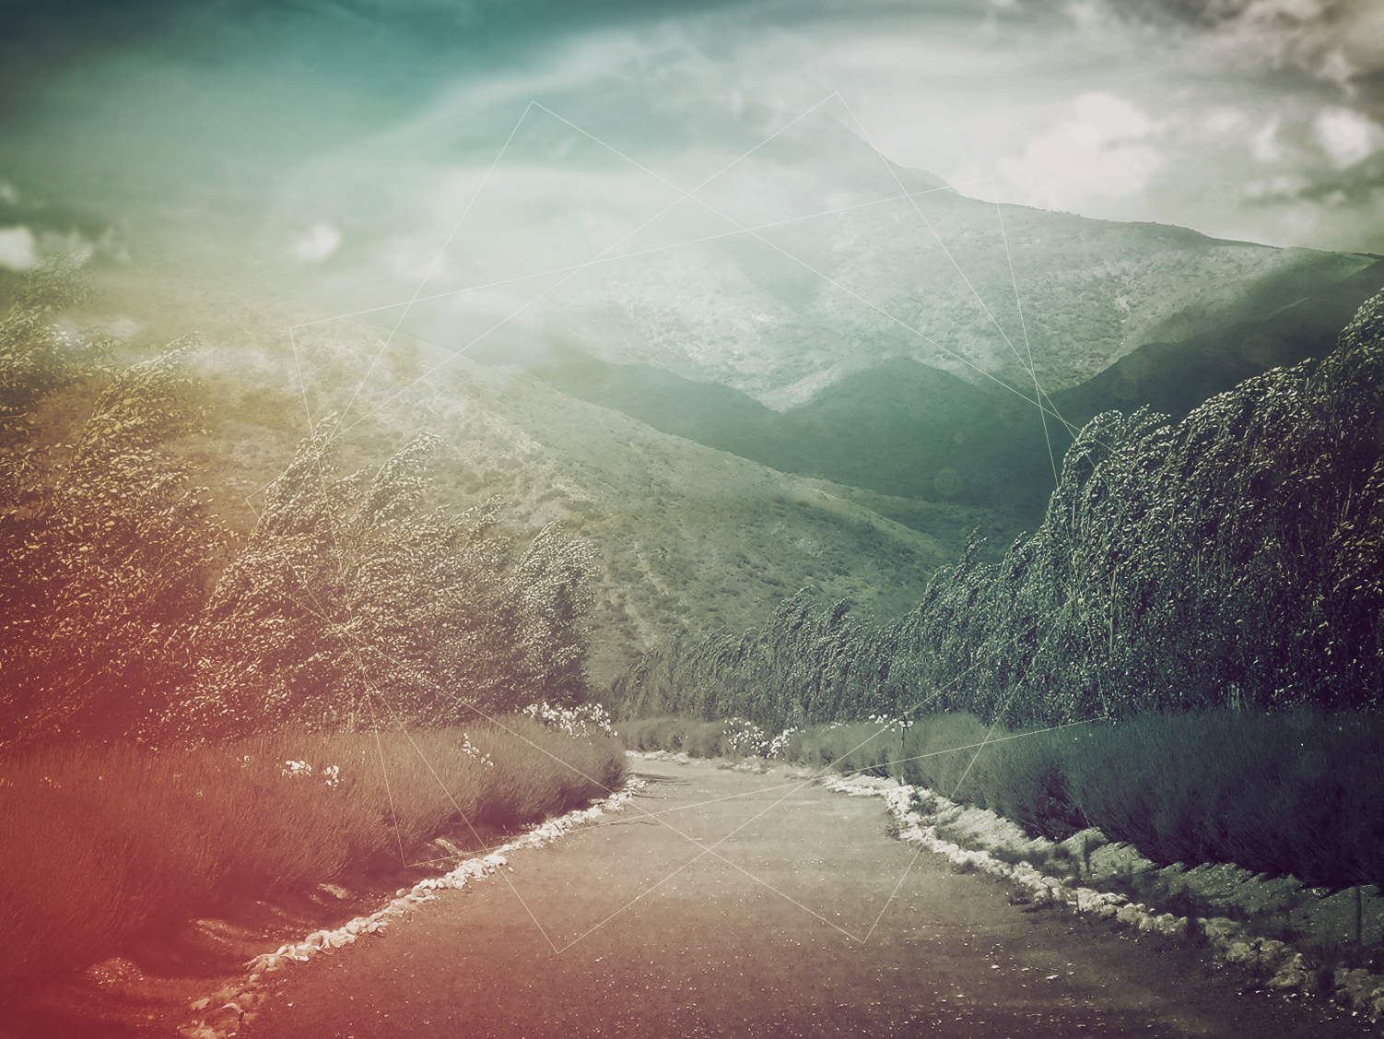
I. Travel Advisory

Slide 9
II. Help From The Hills

Slide 10
It came about at noon, that Elijah mocked them and said, “Call out with a loud voice, for he is a god; either he is occupied or gone aside, or is on a journey, or perhaps he is asleep and needs to be awakened.”
(1 Kings 18:27 NASB)

Slide 11
By noon, Elijah had started making fun of them, taunting, “Call a little louder—he is a god, after all. Maybe he’s off meditating somewhere or other, or maybe he’s gotten involved in a project, or maybe he’s on vacation. You don’t suppose he’s overslept, do you, and needs to be waked up?”
(I Kings 18:27 The Message)

Slide 12
“Surely, the hills are a deception,
A tumult on the mountains.
Surely in the LORD our God
Is the salvation of Israel.
(Jeremiahs 3:23)

Slide 13
No test or temptation that comes your way is beyond the course of what others have had to face. All you need to remember is that God will never let you down; he’ll never let you be pushed past your limit; he’ll always be there to help you come through it. (1 Corinthians 10:13 The Message)

Slide 15
And we know that God causes all things to work together for good to those who love God, to those who are called according to His purpose. (Romans 8:28)

Slide 16
III. Travel Companion

Slide 17


