Slide 2
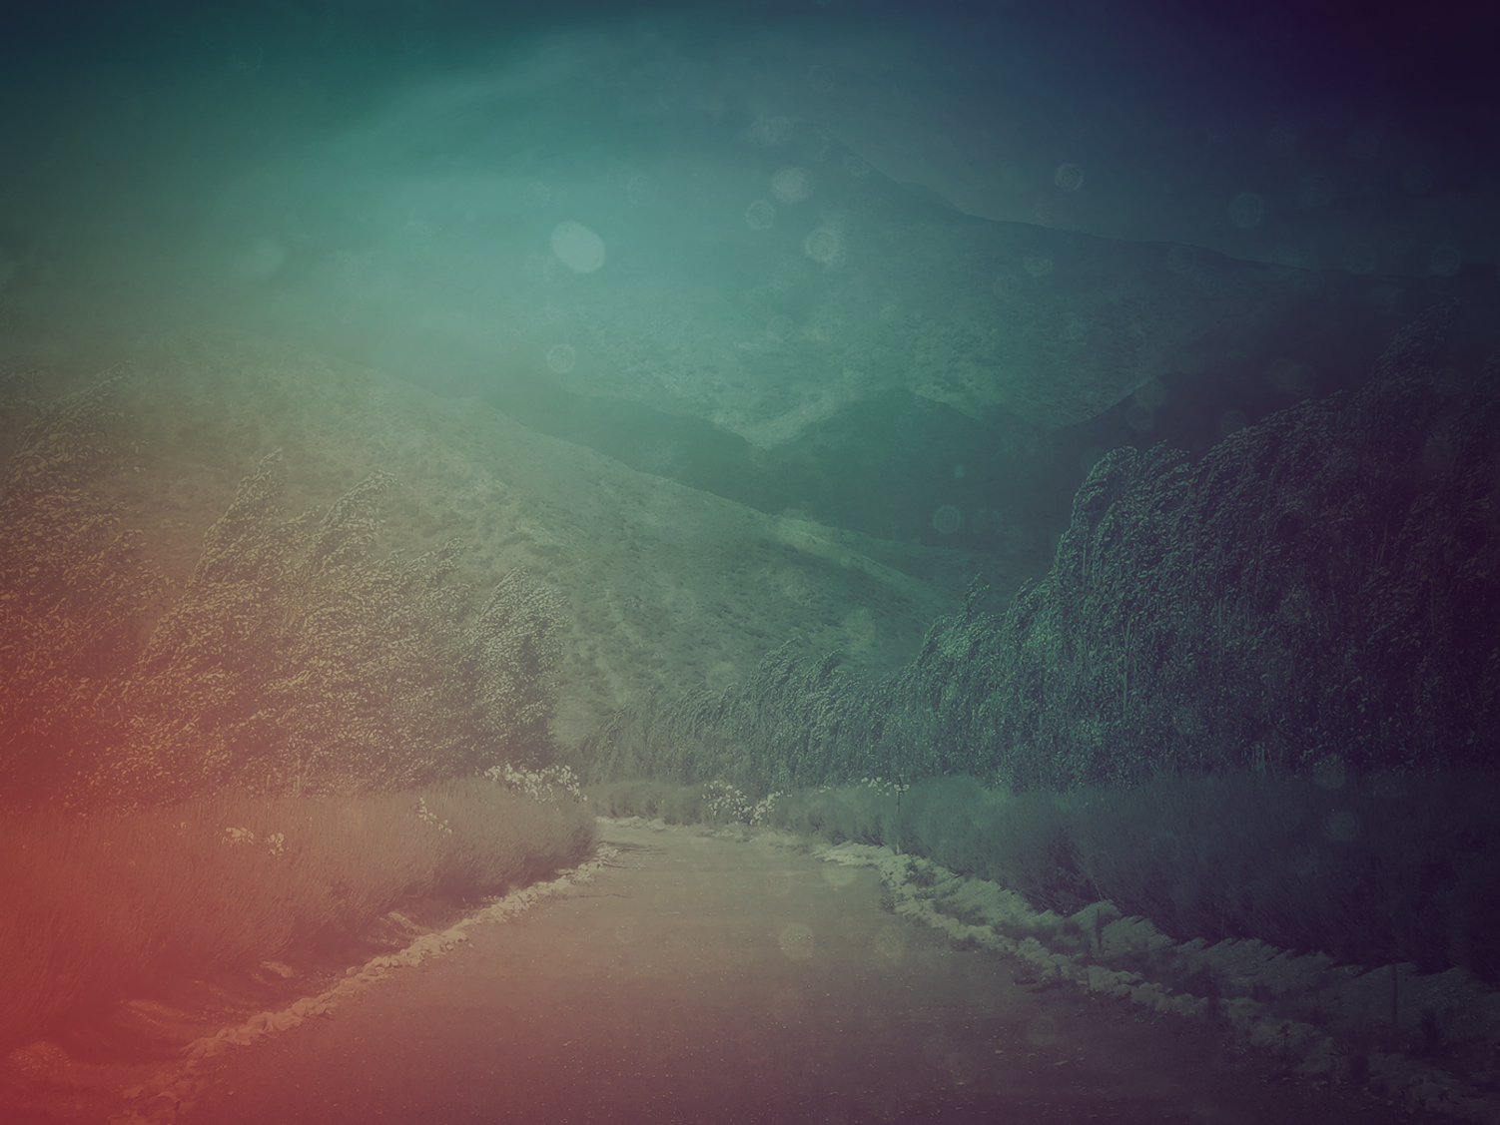
I’m in trouble. I cry to God, desperate for an answer:
“Deliver me from the liars, God!
They smile so sweetly but lie through their teeth.”
- Psalm 120

Slide 3
Do you know what’s next, can you see what’s coming, all you barefaced liars?
Pointed arrows and burning coals will be your reward.
- Psalm 120

Slide 4
I’m doomed to live in Meshech, cursed with a home in Kedar,
My whole life lived camping among quarreling neighbors.
- Psalm 120

Slide 5
I’m all for peace, but the minute
I tell them so, they go to war!
- Psalm 120

Slide 7
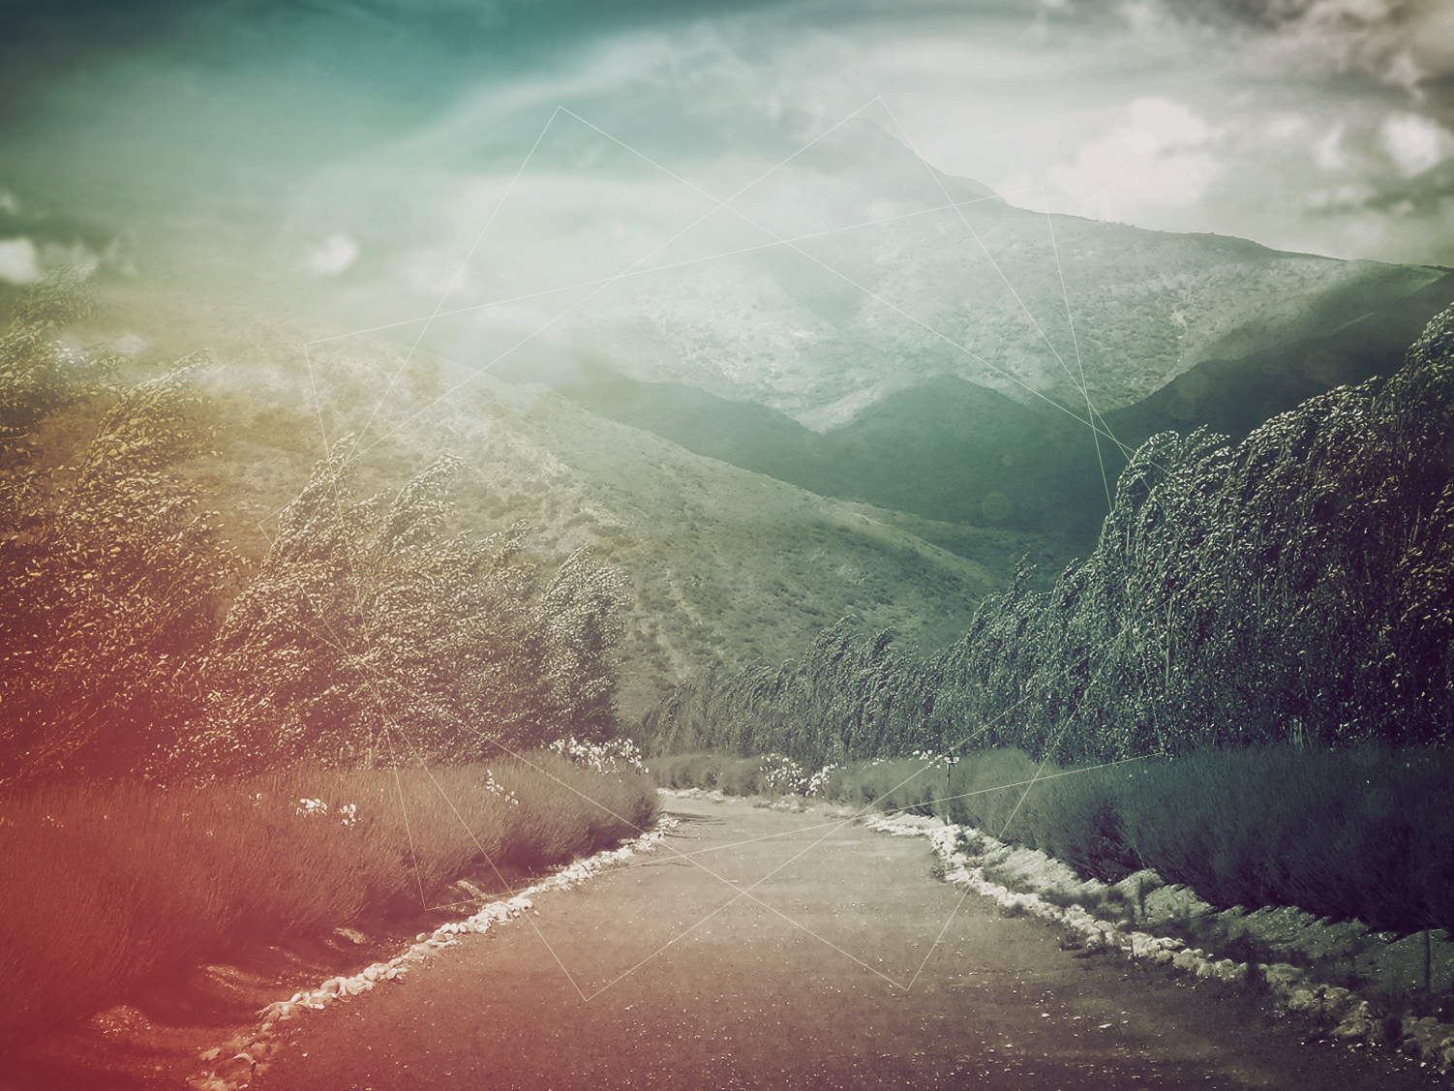
I. Lies Without Error

Slide 8
II. Lightning Illuminating The Crossroads

Slide 9
III. A “NO” IS A “YES”
I’m doomed to live in Meshech,
cursed with a home in Kedar,
My whole life lived camping
among quarreling neighbors
- Psalm 120:5-6

Slide 10
Eili Wisel wrote, “A traveler loses his way in a forest; it is dark and he is afraid. Danger lurks behind every tree. A storm shatters the silence. The fool looks at the lightning, the wise man at the road that lies – illuminated- before him.”

Slide 11
Do you know what’s next, can you see what’s coming, all you barefaced liars?
Pointed arrows and burning coals will be your reward.
- Psalm 120:3-4

Slide 12
“On that Day, there will be a highway all the way from Egypt to Assyria: Assyrians will have free range in Egypt and Egyptians in Assyria. No longer rivals, they’ll worship together, Egyptians and Assyrians! (Isaiah 19:23 The Message)

Slide 13
I’m all for peace, but the minute
I tell them so, they go to war!

Slide 14
But Peter and the apostles answered, “We must obey God rather than men. “The God of our fathers raised up Jesus, whom you had put to death by hanging Him on a cross.

Slide 15
“He is the one whom God exalted to His right hand as a Prince and a Savior, to grant repentance to Israel, and forgiveness of sins. “And we are witnesses of these things; and so is the Holy Spirit, whom God has given to those who obey Him.” (Acts 5:29-32)

Slide 16


