Slide 1
4
His Last Command

Slide 2
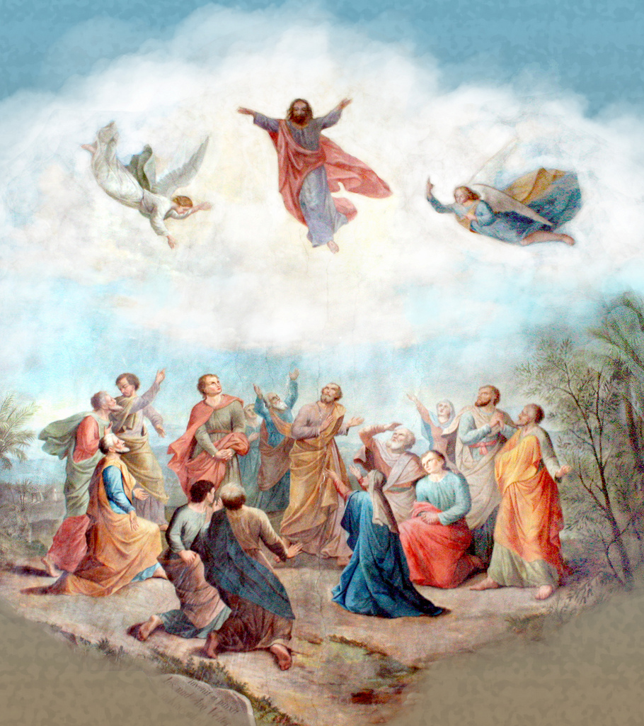

Slide 3
¹⁰ And as they were gazing intently into the sky while He was going, behold, two men in white clothing stood beside them. ¹¹ They also said, “Men of Galilee, why do you stand looking into the sky? This Jesus, who has been taken up from you into heaven, will come in just the same way as you have watched Him go into heaven.”
- Acts 1:10-11

Slide 4
¹⁶ But the eleven disciples proceeded to Galilee, to the mountain which Jesus had designated. ¹⁷ When they saw Him, they worshiped Him; but some were doubtful. ¹⁸ And Jesus came up and spoke to them, saying, “All authority has been given to Me in heaven and on earth.
- Matthew 28:16-18

Slide 5
¹⁹ Go therefore and make disciples of all the nations, baptizing them in the name of the Father and the Son and the Holy Spirit, ²⁰ teaching them to observe all that I commanded you; and lo, I am with you always, even to the end of the age.”
- Matthew 28:19-20

Slide 6
He who has believed and has been baptized shall be saved; but he who has disbelieved shall be condemned.
- Mark 16:16

Slide 7
¹⁷ These signs will accompany those who have believed: in My name they will cast out demons, they will speak with new tongues; ¹⁸ they will pick up serpents, and if they drink any deadly poison, it will not hurt them; they will lay hands on the sick, and they will recover.”
- Mark 16:17-18

Slide 8
The 3 Parts of the Command
Tell the Good News
Baptize believers
Teach the converts

Slide 9
3 Things That Changed
Absolute exclusivity in religion

Slide 10
And there is salvation in no one else; for there is no other name under heaven that has been given among men by which we must be saved.”
- Acts 4:12

Slide 11
3 Things That Changed
Absolute exclusivity in religion
A final solution is offered

Slide 12
A Final Solution for
{
Sin
Death

Slide 13
As for the days of our life, they contain seventy years,
Or if due to strength, eighty years,
Yet their pride is but labor and sorrow;
For soon it is gone and we fly away.
- Psalm 90:10

Slide 14
Peter said to them, “Repent, and each of you be baptized in the name of Jesus Christ for the forgiveness of your sins; and you will receive the gift of the Holy Spirit.
- Acts 2:38

Slide 15
A Final Solution for
{
Sin → Forgiveness
Death

Slide 16
¹³ for if you are living according to the flesh, you must die; but if by the Spirit you are putting to death the deeds of the body, you will live. ¹⁴ For all who are being led by the Spirit of God, these are sons of God.
- Romans 8:13-14

Slide 17
³⁹ This is the will of Him who sent Me, that of all that He has given Me I lose nothing, but raise it up on the last day. ⁴⁰ For this is the will of My Father, that everyone who beholds the Son and believes in Him will have eternal life, and I Myself will raise him up on the last day.”
- John 6:39-40

Slide 18
A Final Solution for
{
Sin → Forgiveness
Death → Resurrection

Slide 19
3 Things That Changed
Absolute exclusivity in religion
A final solution is offered
The world had to choose

Slide 20
He who has believed and has been baptized shall be saved; but he who has disbelieved shall be condemned.
- Mark 16:16

Slide 21
The Choice is:
Exclusive
Terrifying
Attacks
Demanding
Weighty
Provocative

Slide 22
So then, those who had received his word were baptized; and that day there were added about three thousand souls.
- Acts 2:41

Slide 23
Summary
Jesus’ final command is a turning point in human history because it:
Establishes Jesus as the only Savior
Reveals God’s solution to sin and death
Offers a clear choice to mankind

Slide 24
Everyone must choose!

